Slide 1

Atmospheric Data
Shengli (Bruce) Jiang, Alexander D. Smith, Victor M. Zavala
Department of Chemical & Biological Engineering

Slide 2
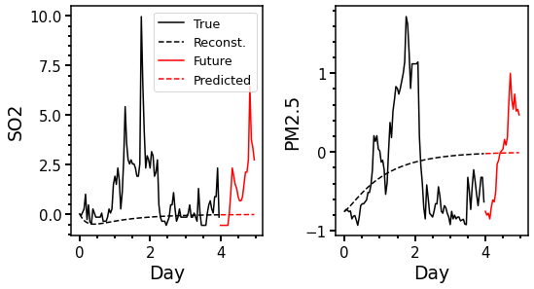
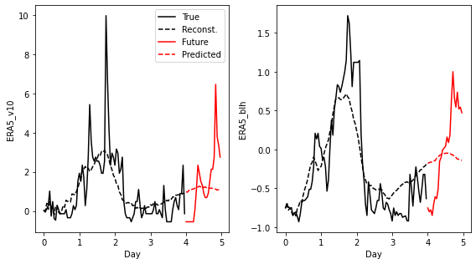
Recap
Single Site
All Sites
Considering all site information is better than a single site.
Include {weekend, weekday, holiday} into variables.
Check mean, std and correlation in the B matrix.
Time series contains a lot of random variation.

Slide 3
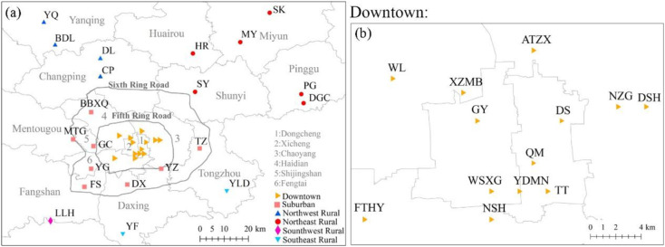
Location of All 34 Sites
We will consider the clustering of the sites (especially downtown).
Hua, Jinxi, et al. Science of The Total Environment 750 (2021): 141575.

Slide 4
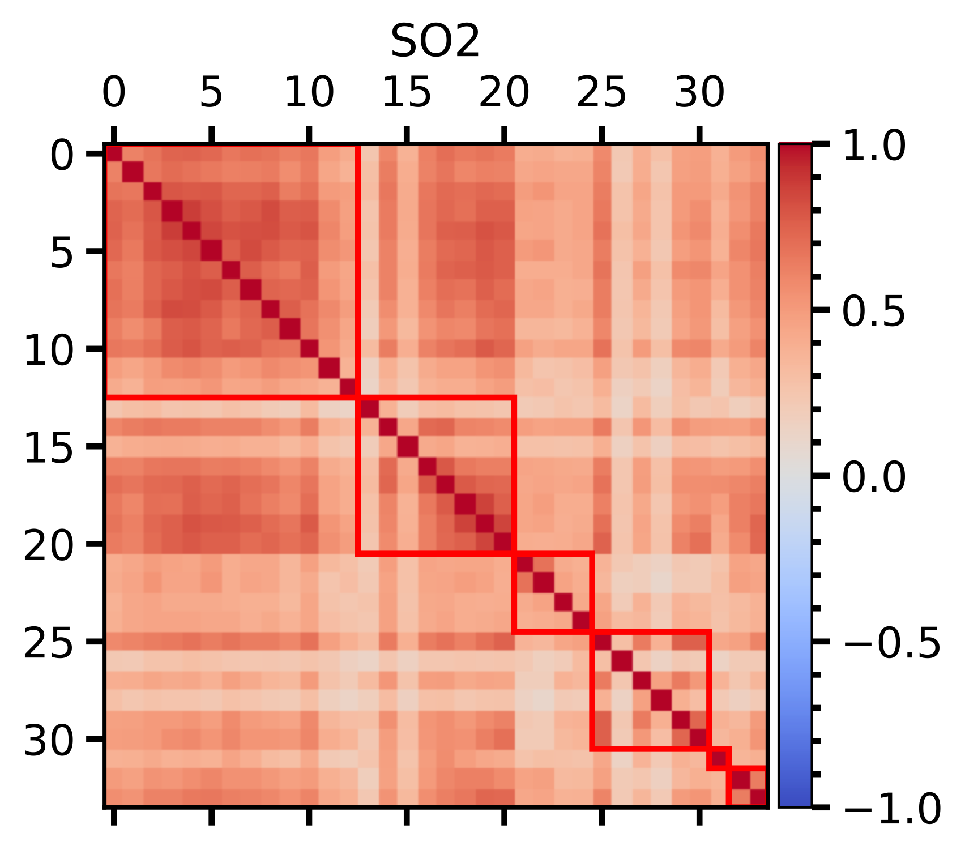
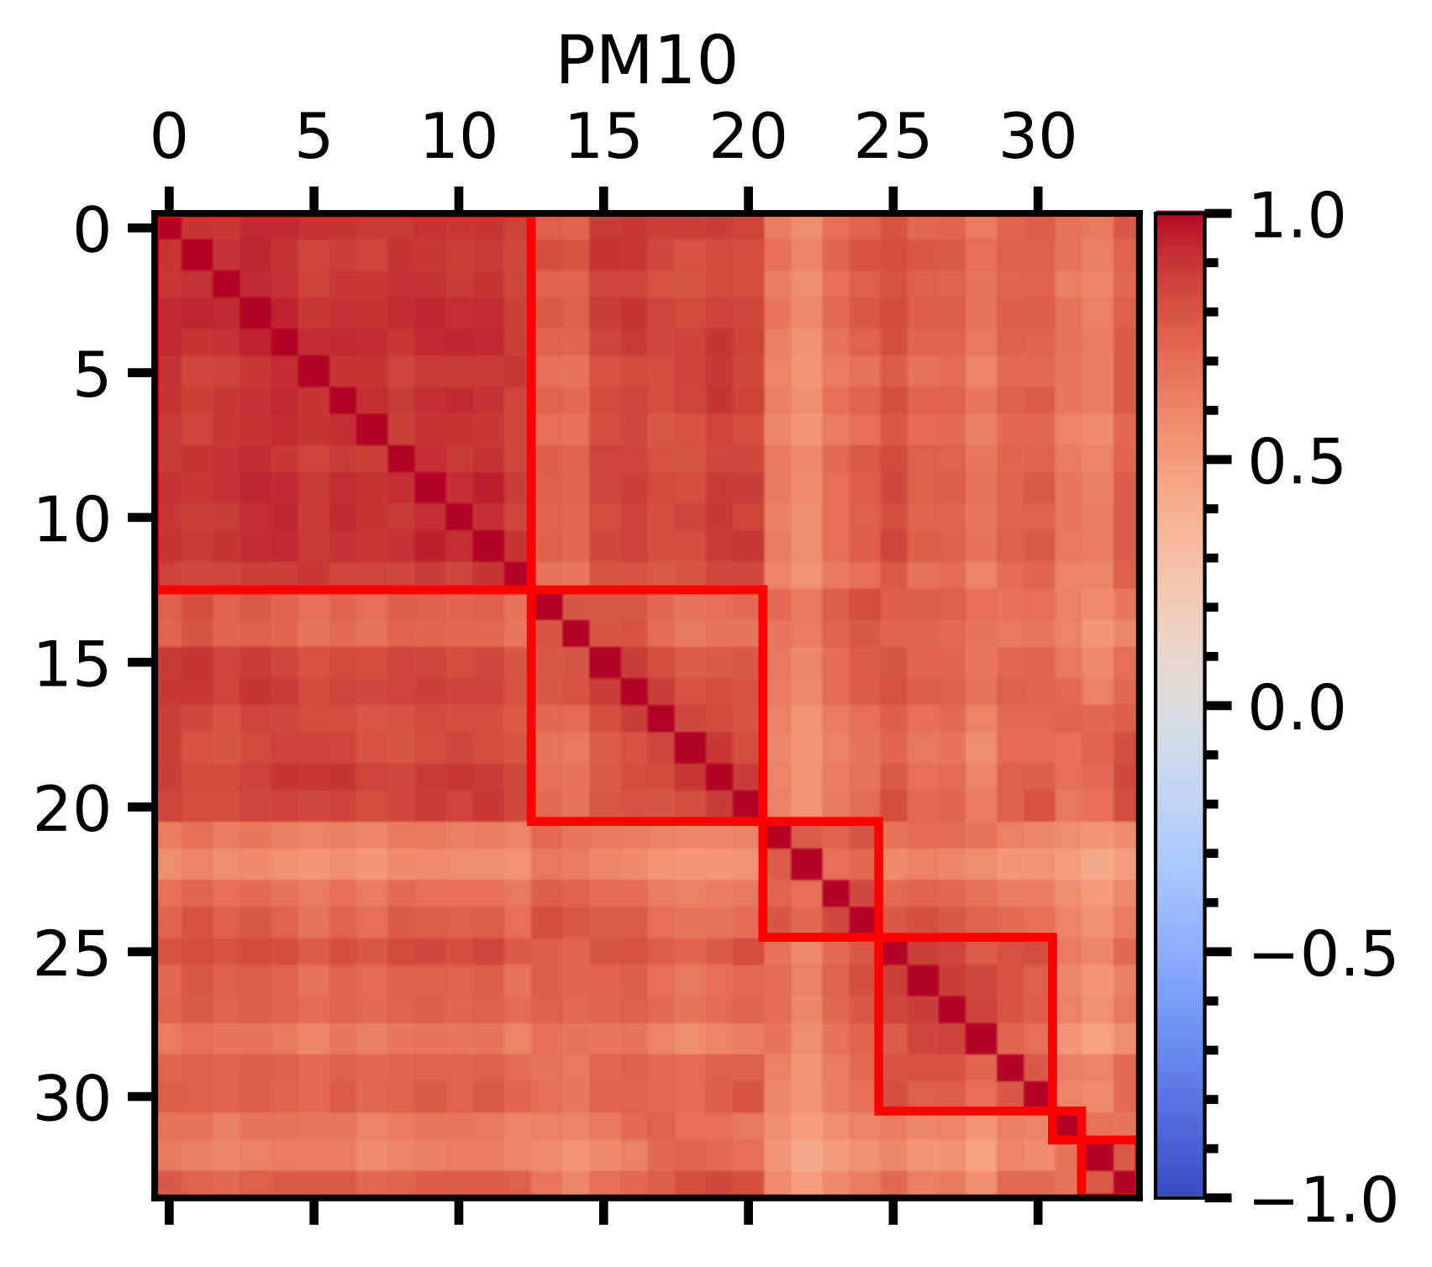
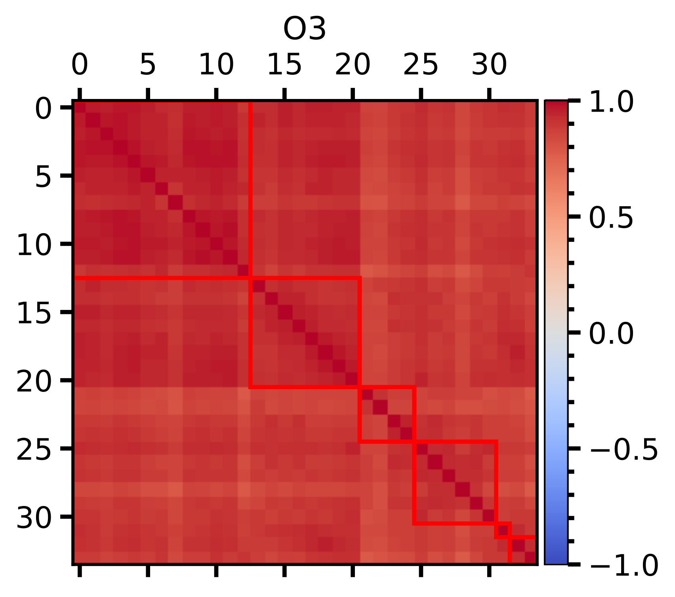
Spatial Correlation
downtown
suburban
northern rural
southern rural
All positive correlations.
(sites are relatively close, not in province level)

Slide 5
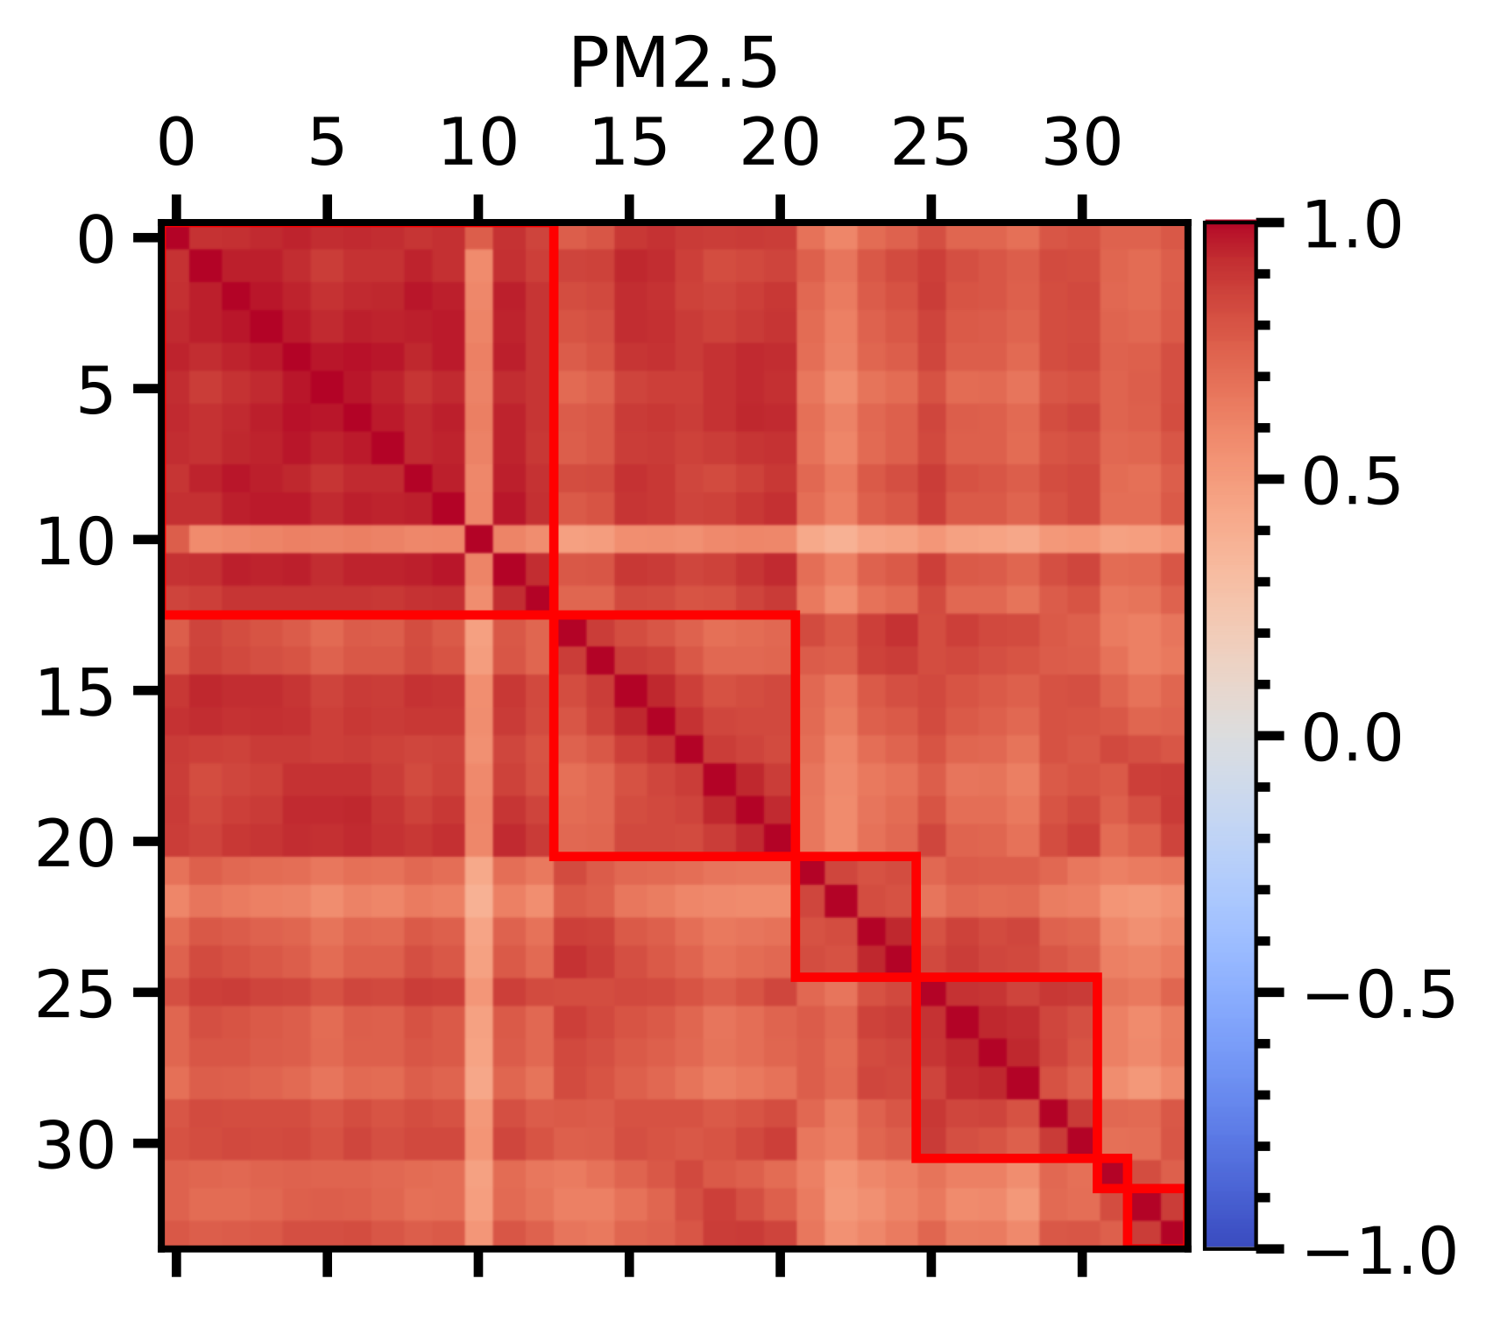
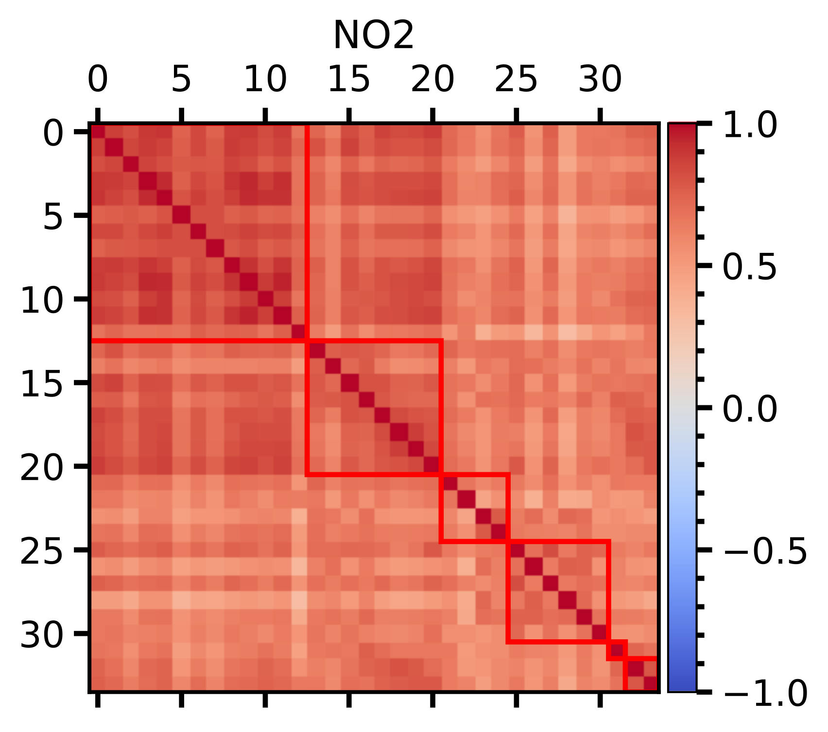
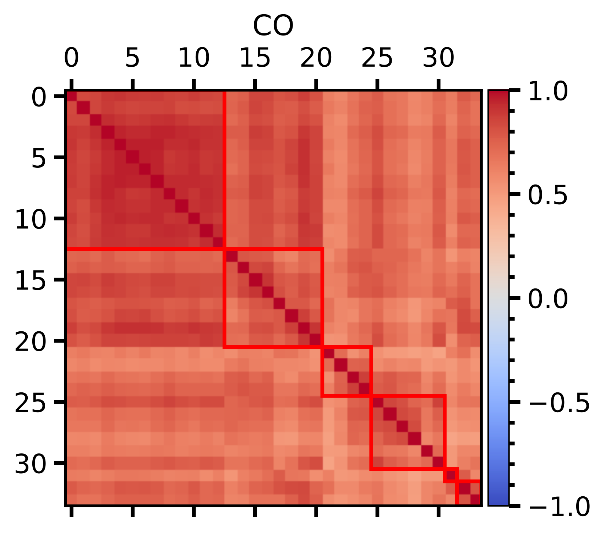
Spatial Correlation
FTHY (Fengtai Park)
All positive correlations.
(sites are relatively close, not in province level)

Slide 6
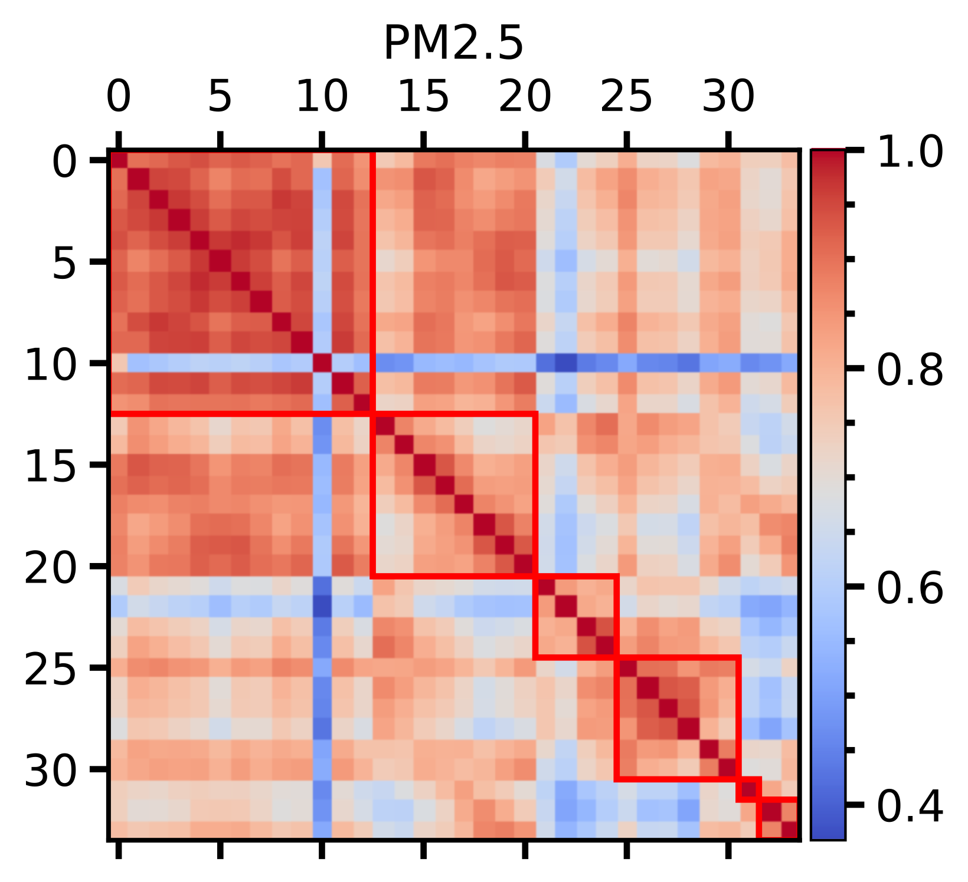
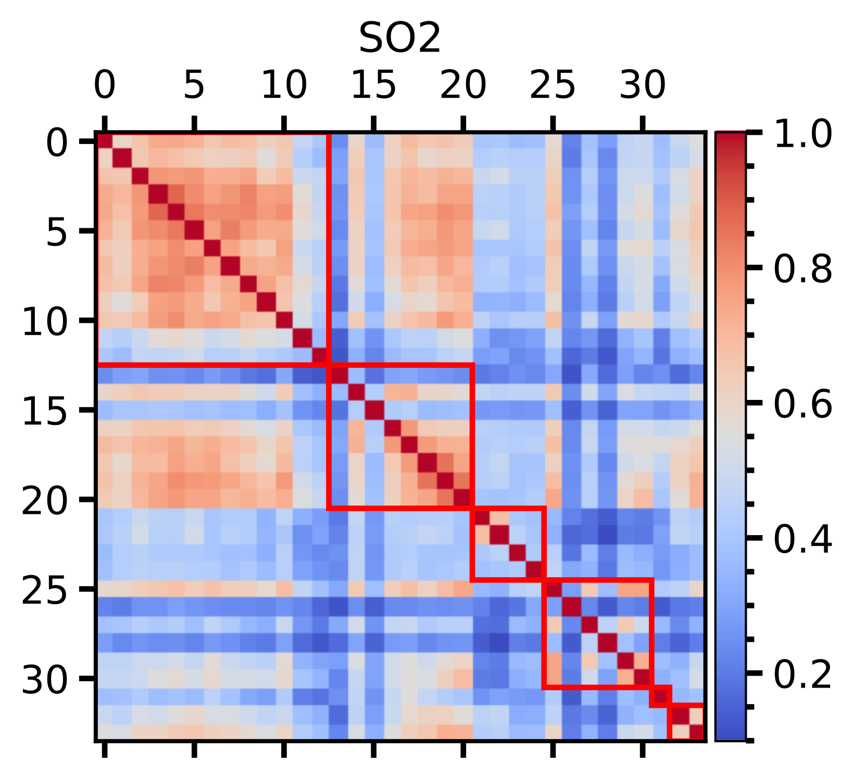
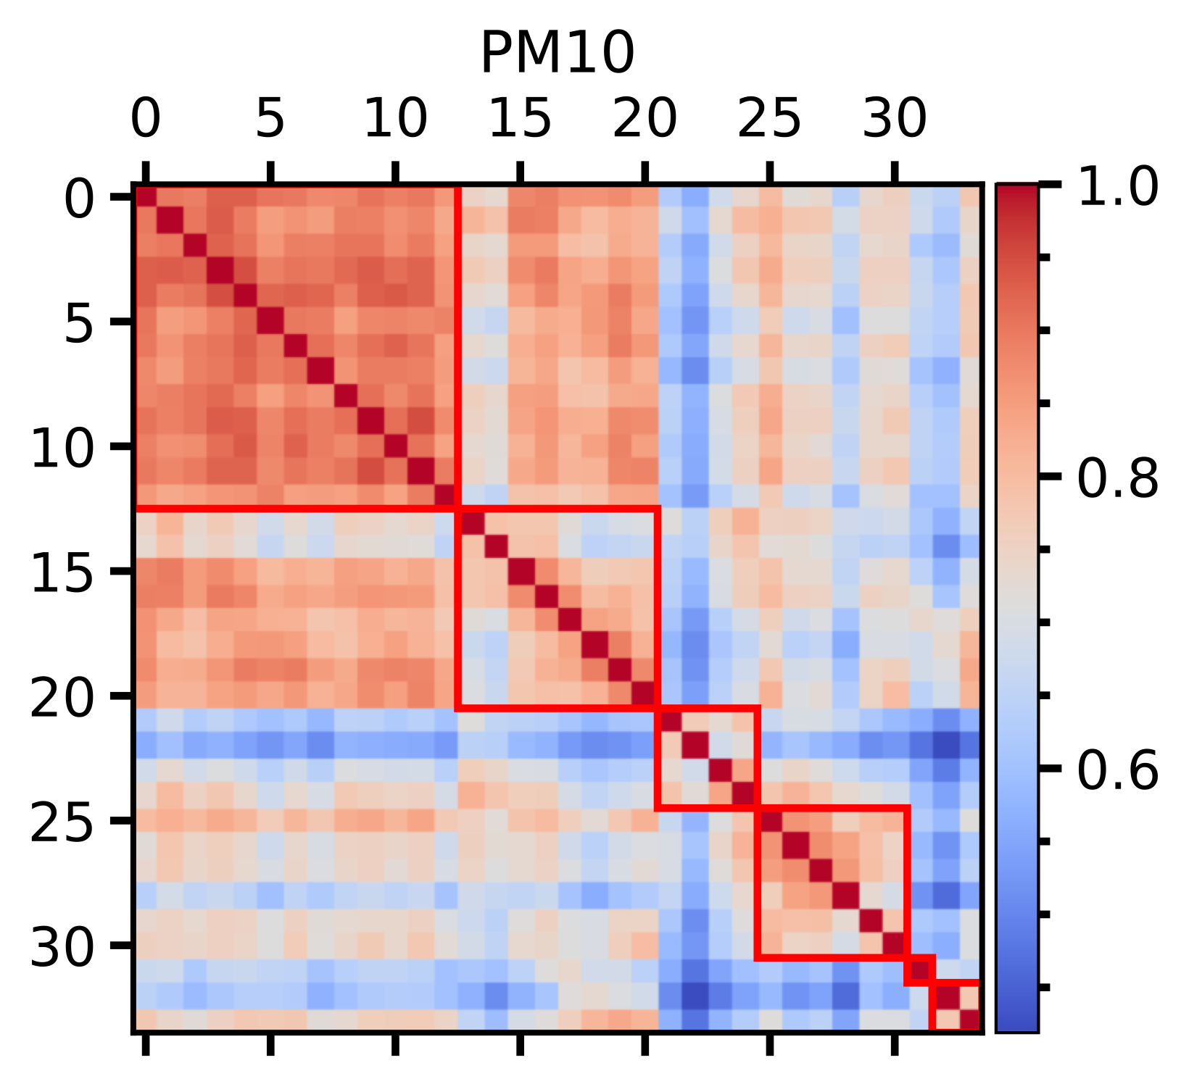
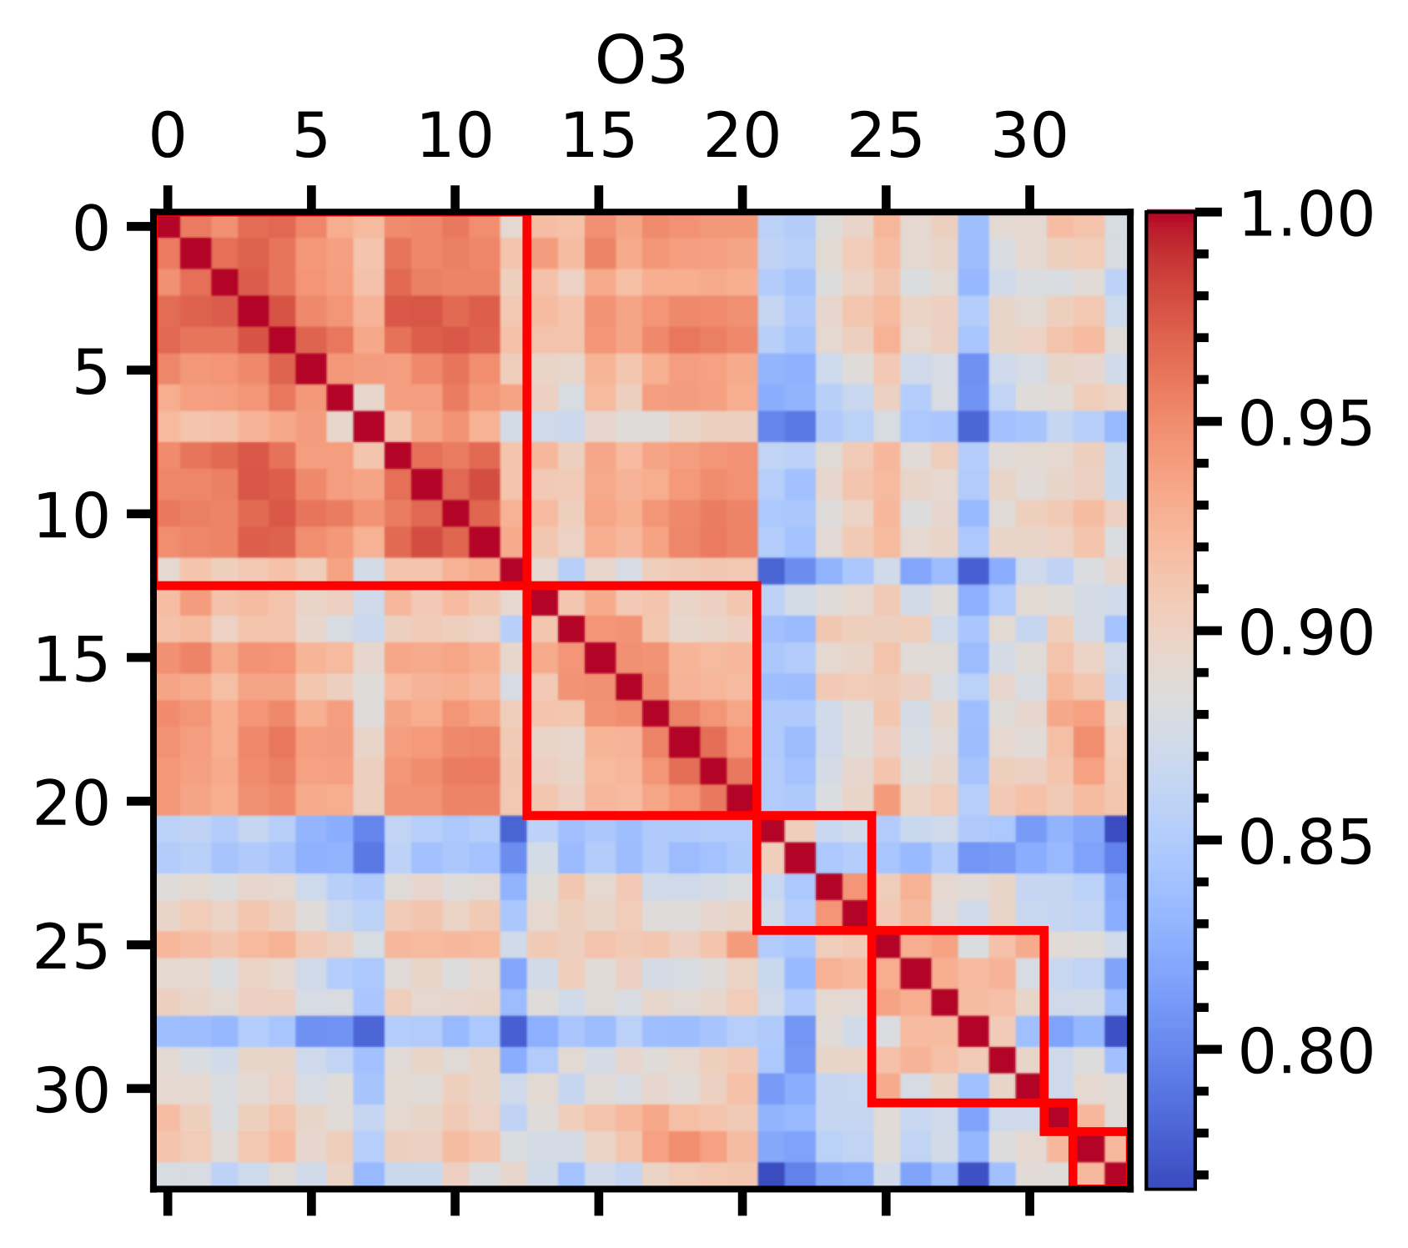
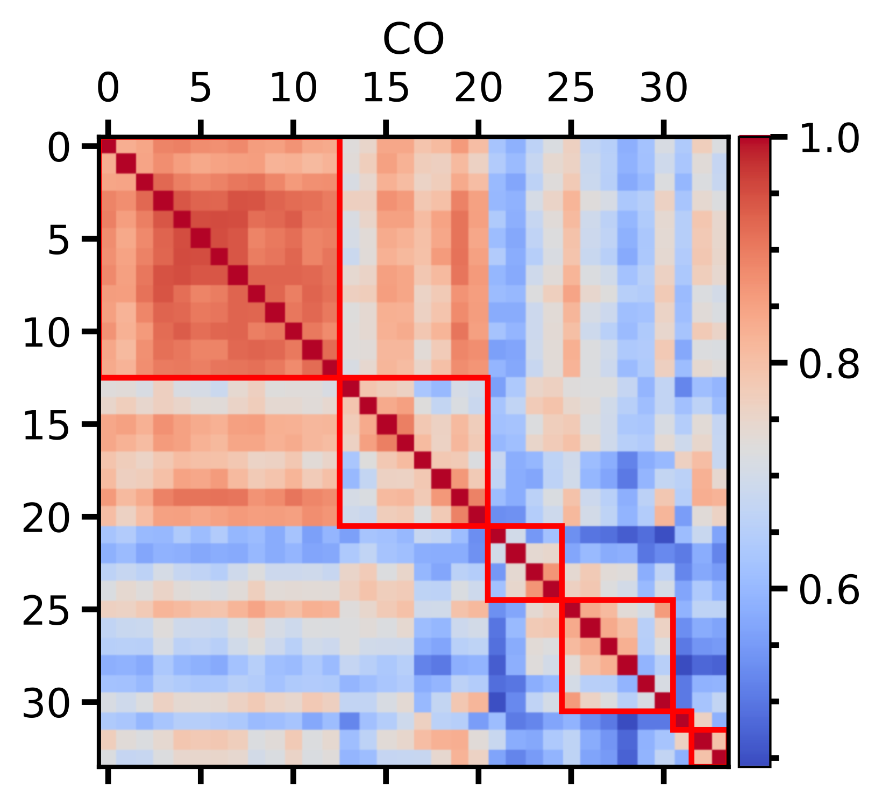
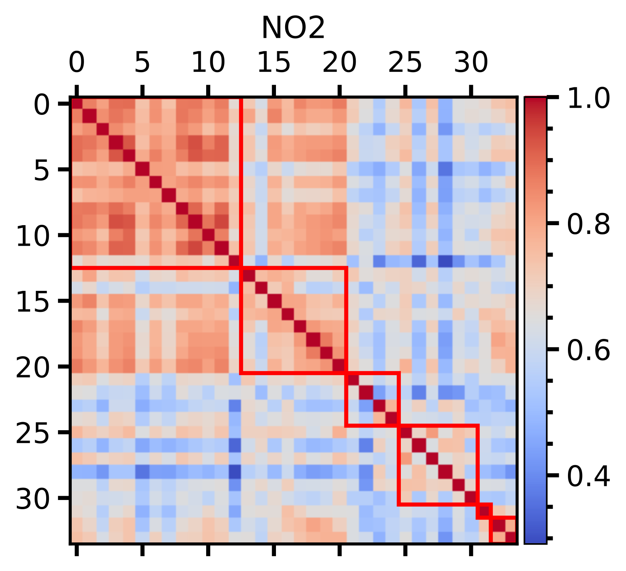
Changing scales, we can see clustering.

Slide 7
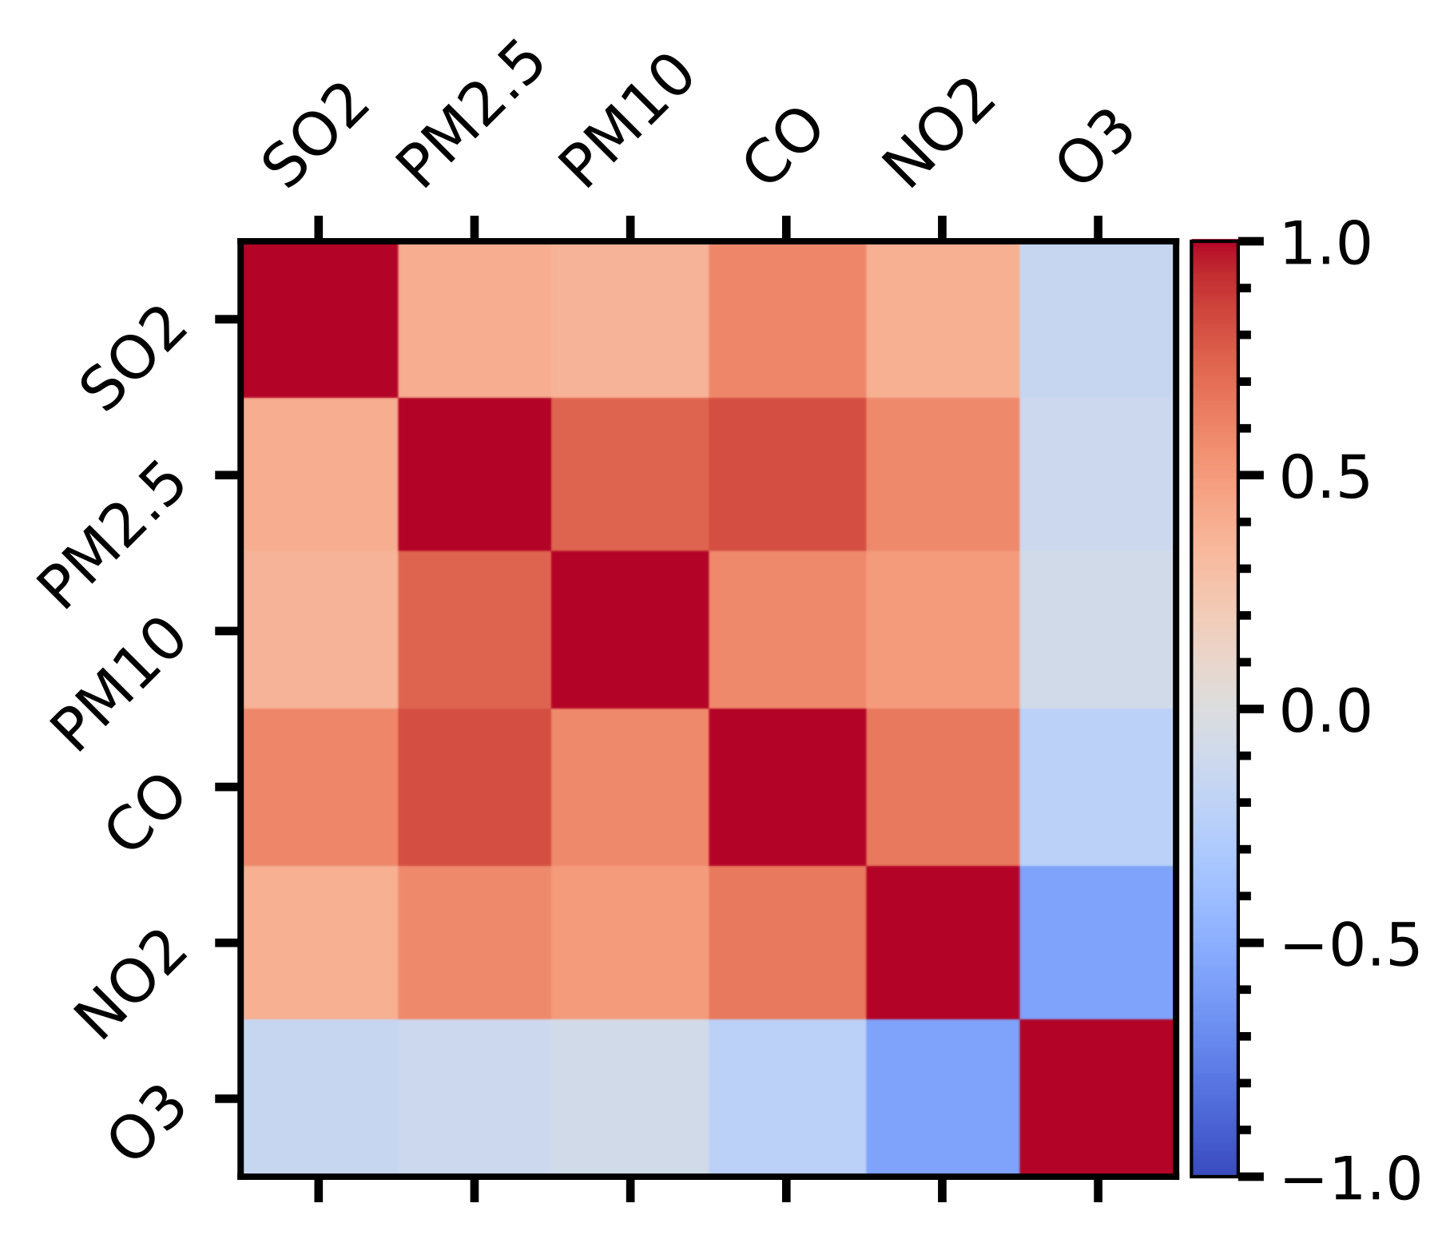
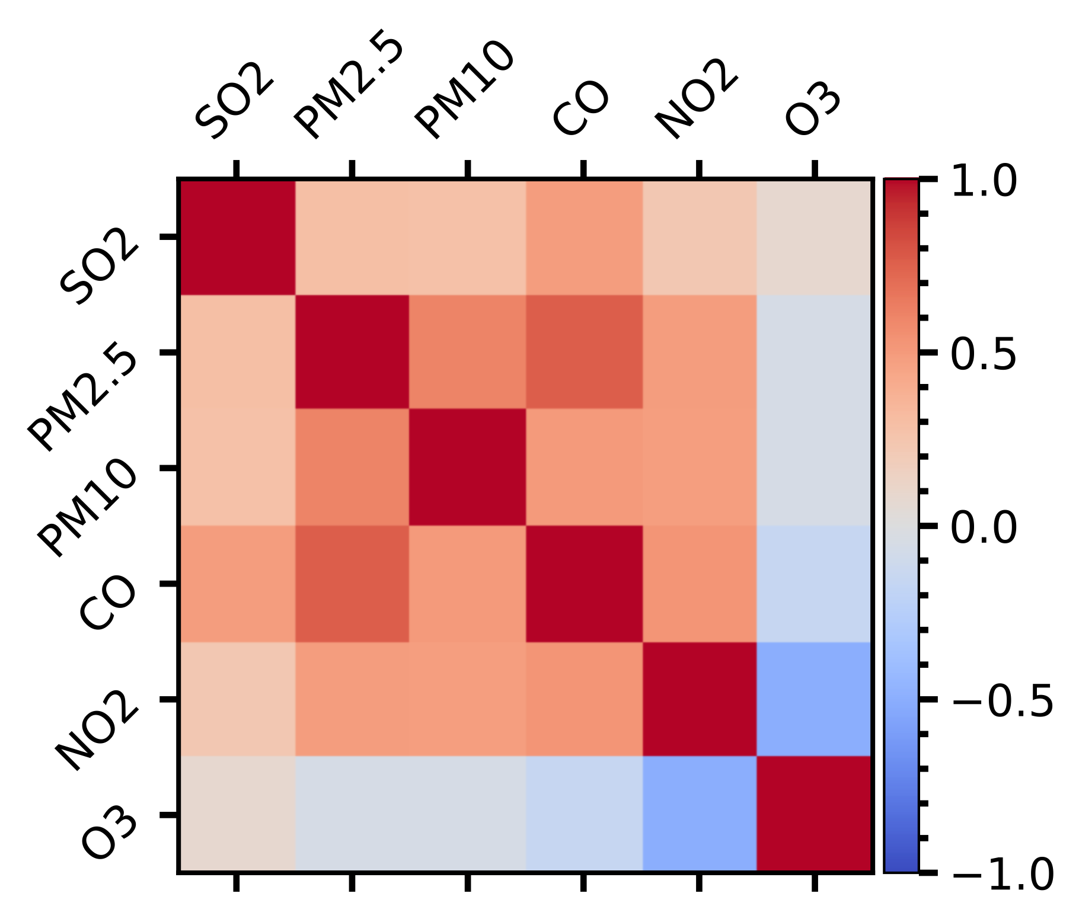
Contaminant Correlation
In cold season with weak atmospheric oxidation, the enhanced PM2.5 levels suppressed surface solar radiation, which could weaken O3 production for decreasing ambient O3 level with the low diurnal peaks.
O3 and other contaminates have negative correlations.

Slide 8
Dynamic Mode Decomposition
DMD
Reconstruction
DMD with Forcing
1 Step Forecasting
DMD with Time Delay
Long Time Forecasting
DMD with TD&F
Correlation B Matrix

Slide 9
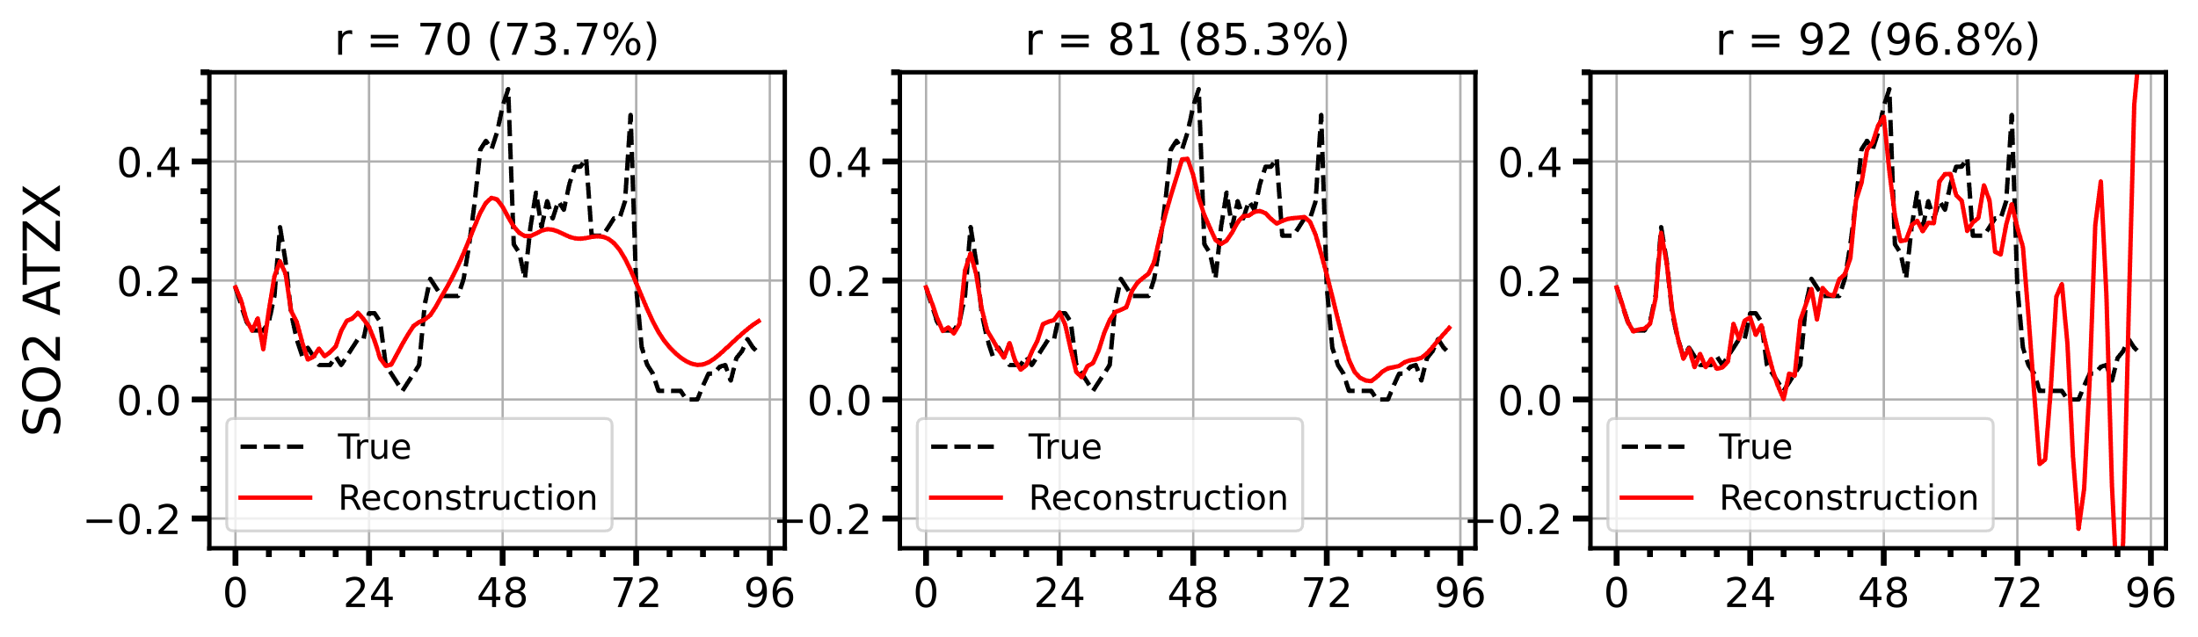
Vanilla DMD
Too much truncation: decay to constant value
Too little truncation: diverge
Best truncation: recapitulate the dominant dynamic

Slide 10
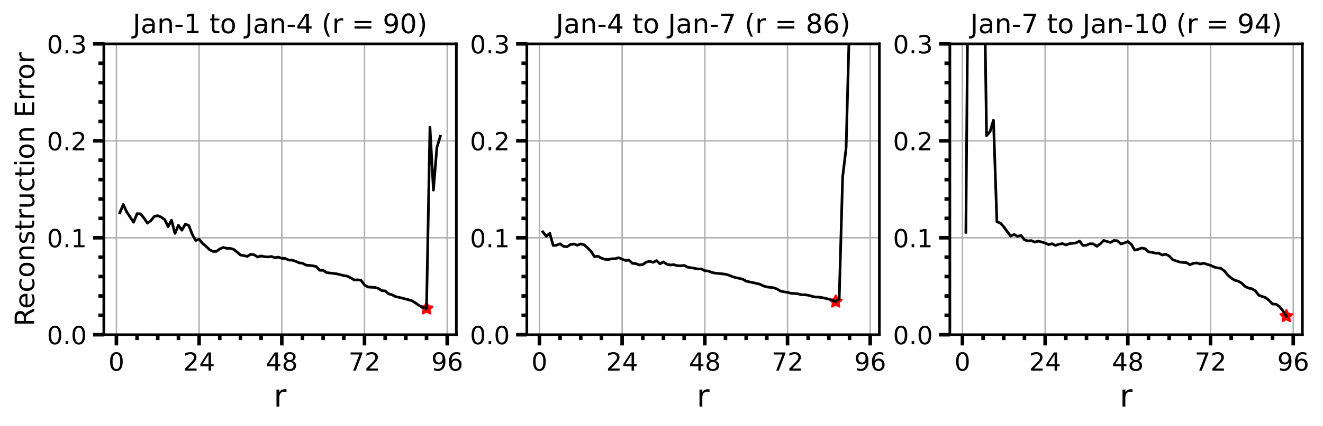
Best Truncation
Optical truncation is about 95% (90/95).

Slide 11
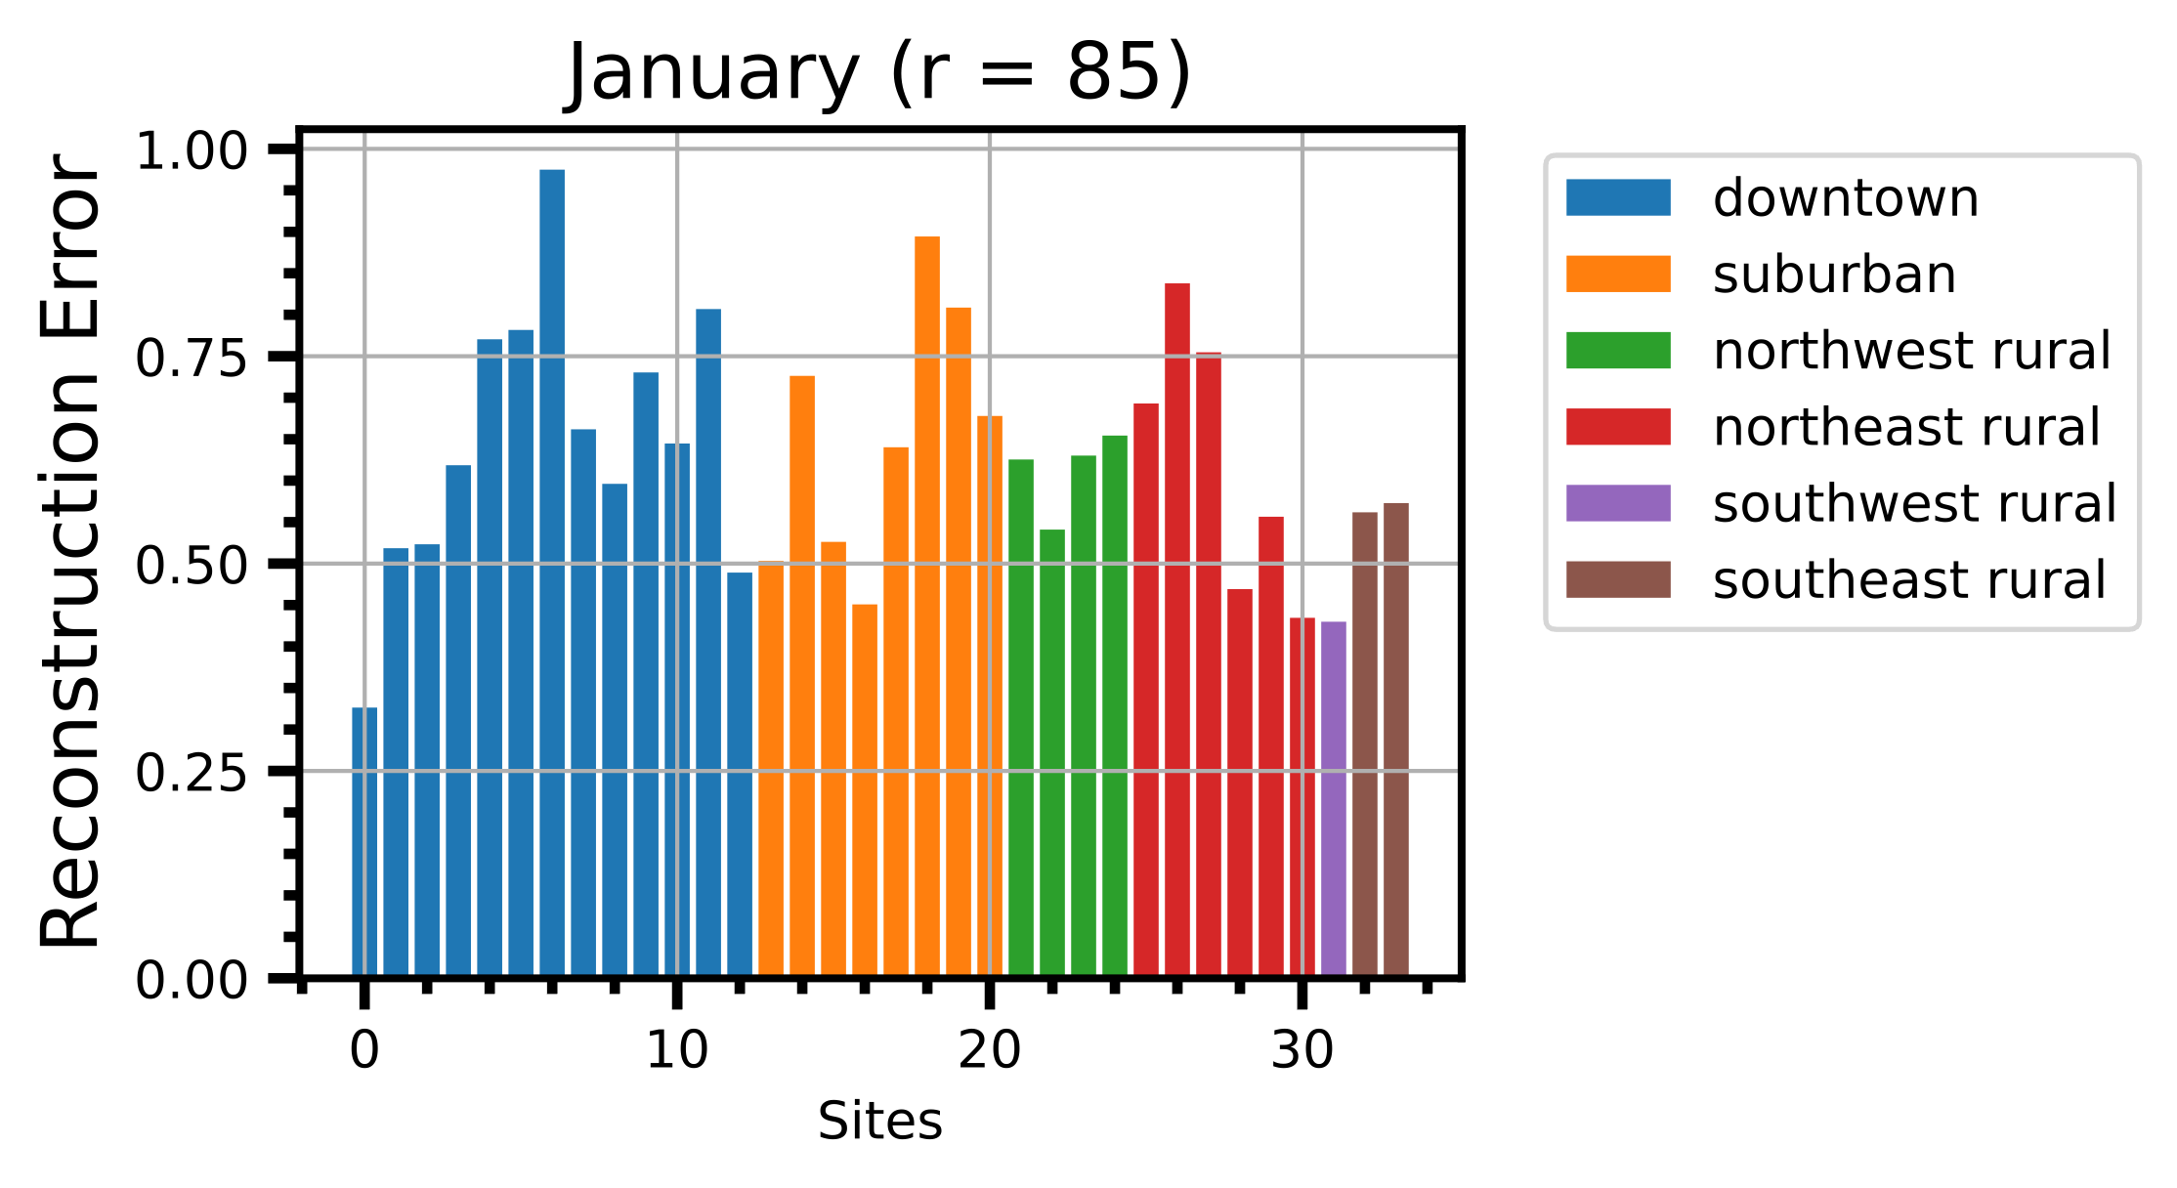
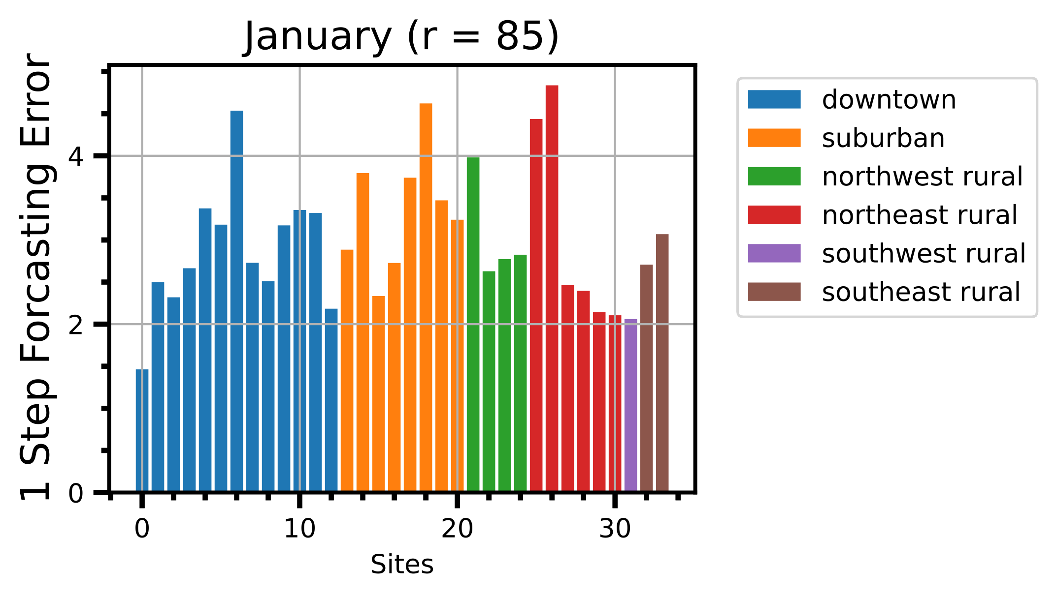
Reconstruction & 1 Step Forecasting
Forecasting error is larger than reconstruction.
Forecasting site pattern is similar to reconstruction.
Errors do not vary significantly based on clustering.

Slide 12
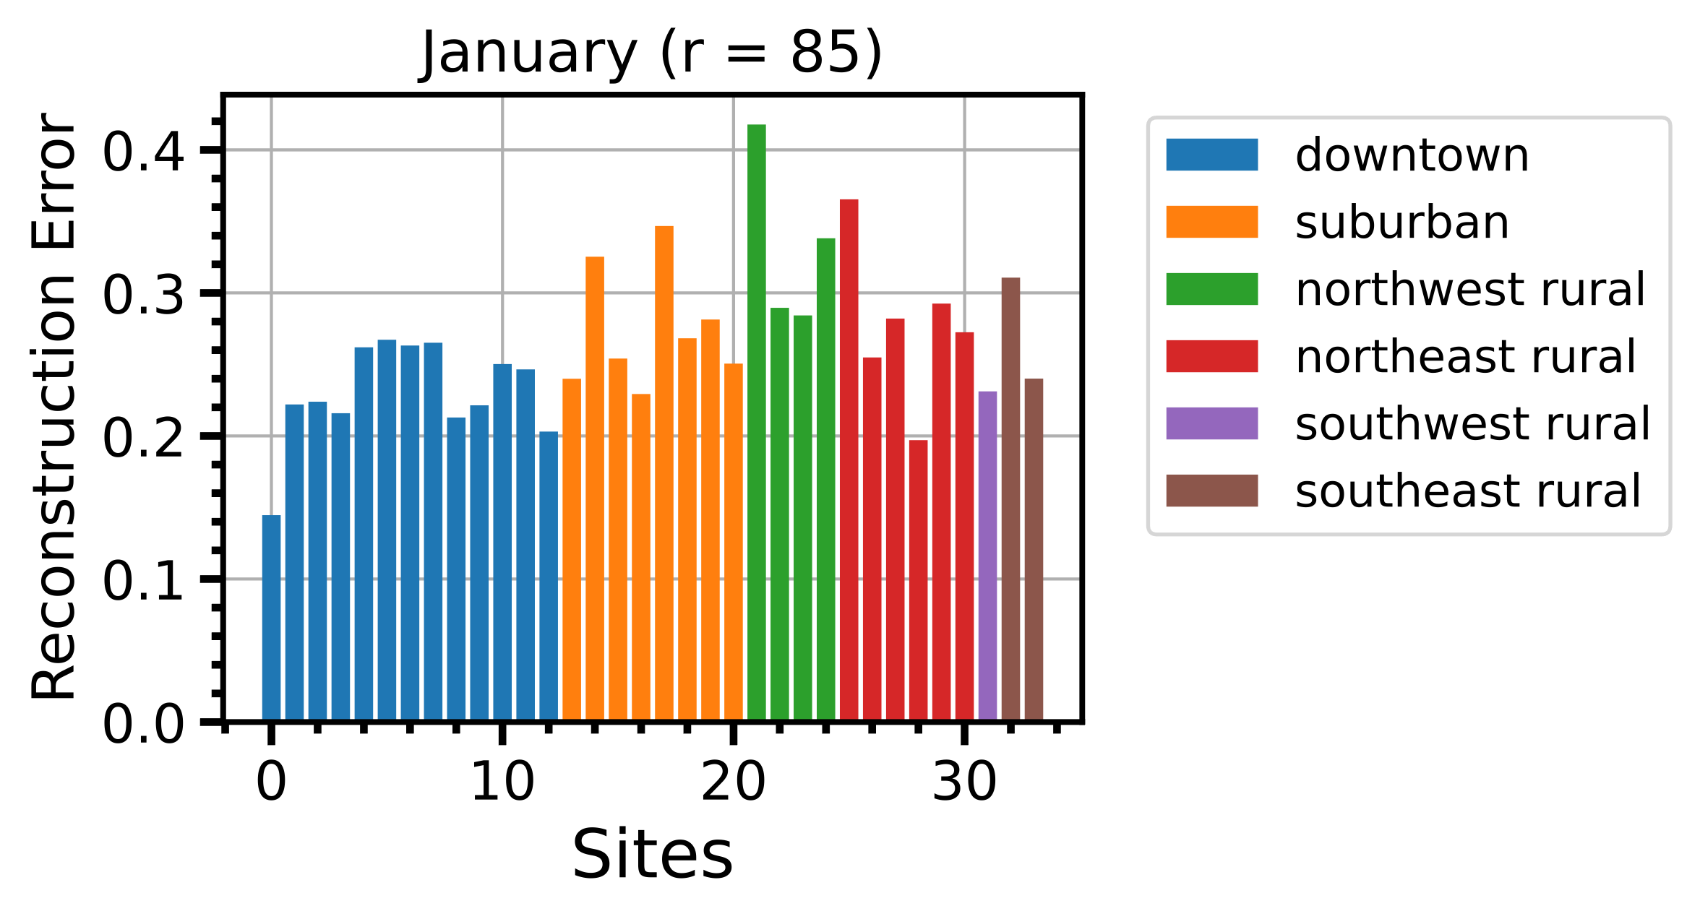
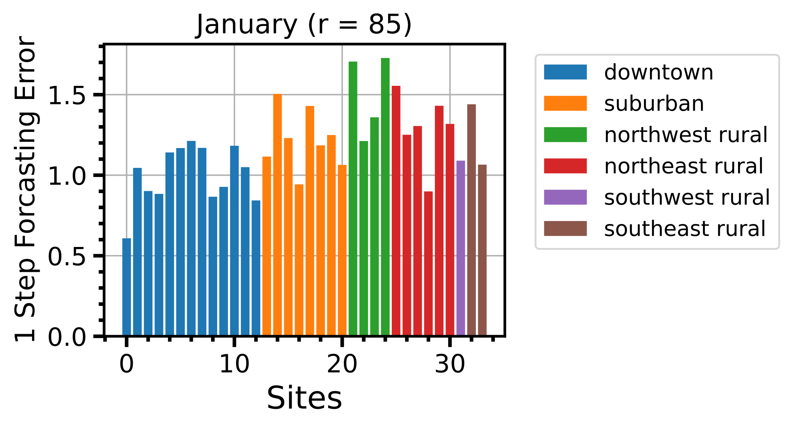
Data Representation -- PCA
Project data to PCA space can reduce errors.
Data representation is important to identify underlying interactions.
e.g., Temp + Pressure affect SO2.
In reality, Temp + Pressure affect hidden var X then directly affects SO2.

Slide 13
Including Holiday Information
Weekday
[1, 0, 0]
Weekend
[0, 1, 0]
Holiday
[0, 0, 1]
Dew Point
Temperature
Boundary Layer Height
Relative Humidity
Wind U Component
Pressure
Wind V Component

Slide 14
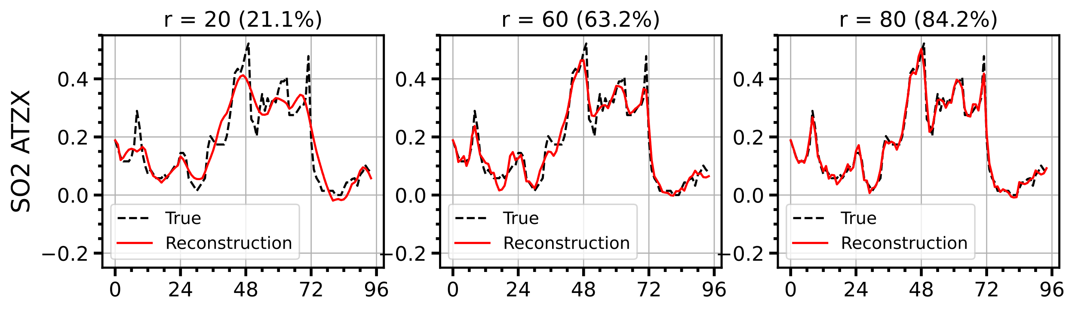
DMD with Forcing
Too much truncation: decay to constant value
Best truncation is always no truncation.

Slide 15
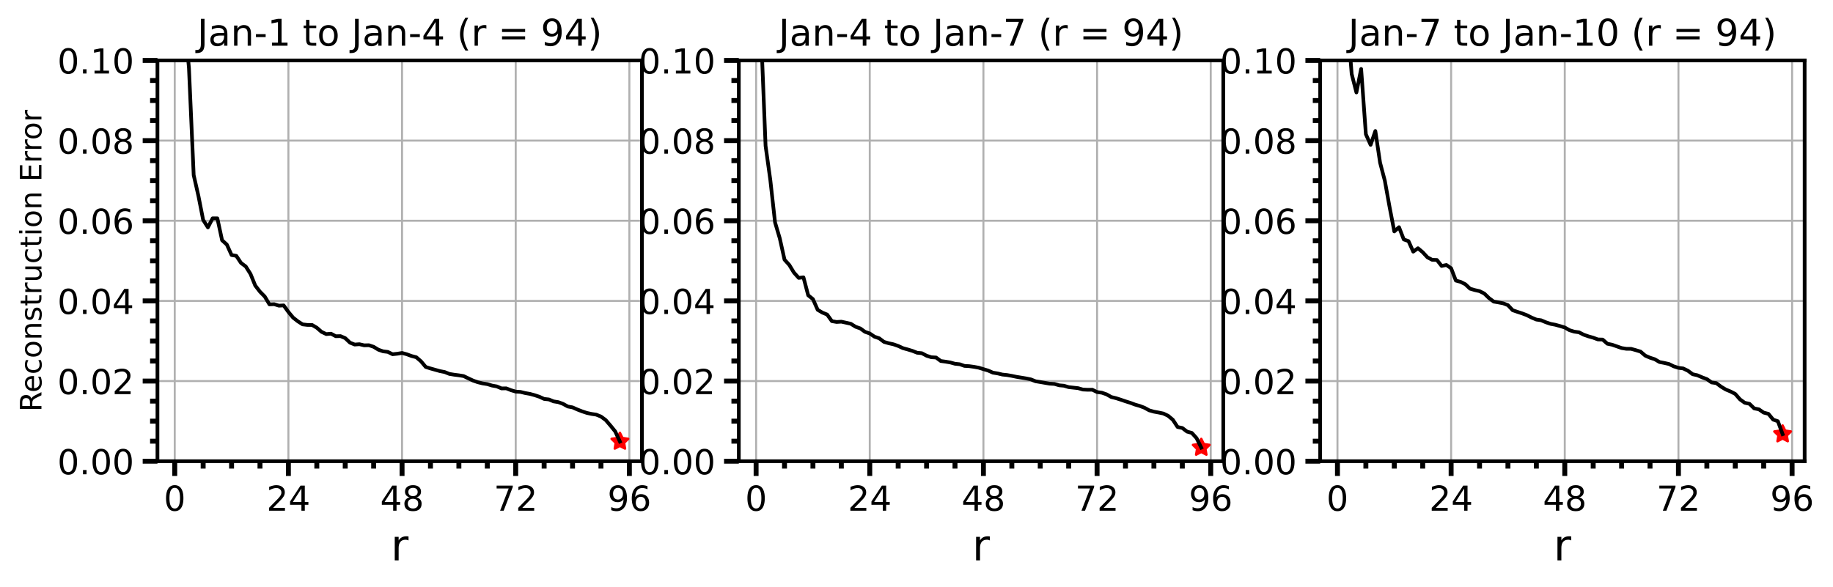
Best Truncation
Too much truncation: decay to constant value
Best truncation is always no truncation.

Slide 16
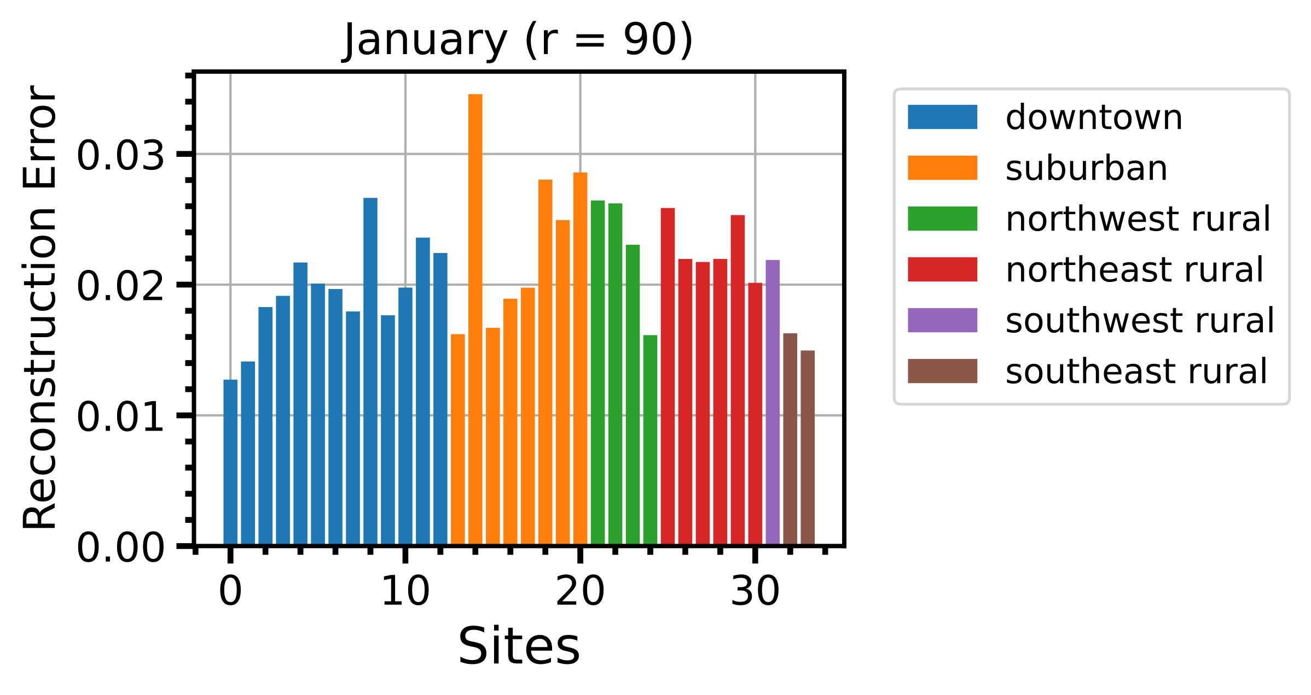

Without Holiday Information
Forecasting error is larger than reconstruction.
Both errors much lower than vanilla DMD (100x).

Slide 17
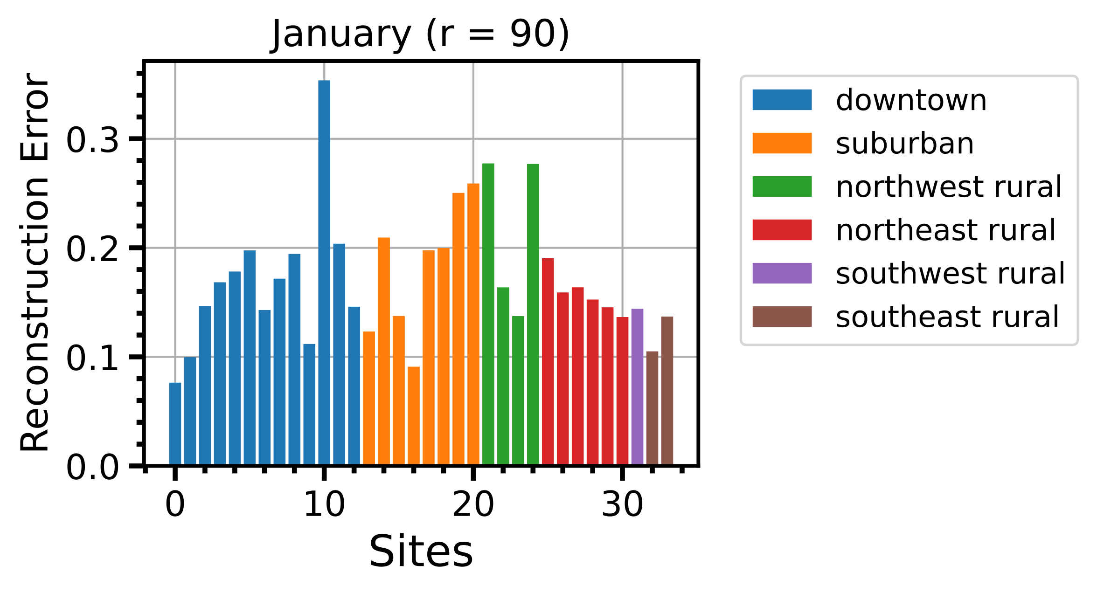
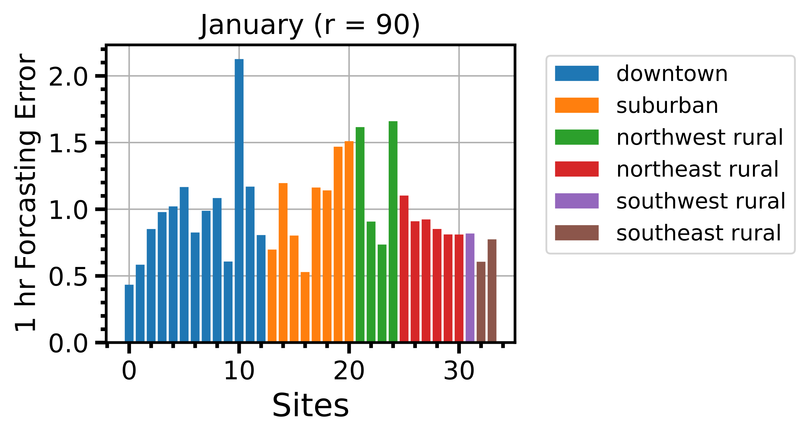
With Holiday Information
Including holiday information increases error.
The reconstruction window is 3 day (holiday information is trivial)

Slide 18
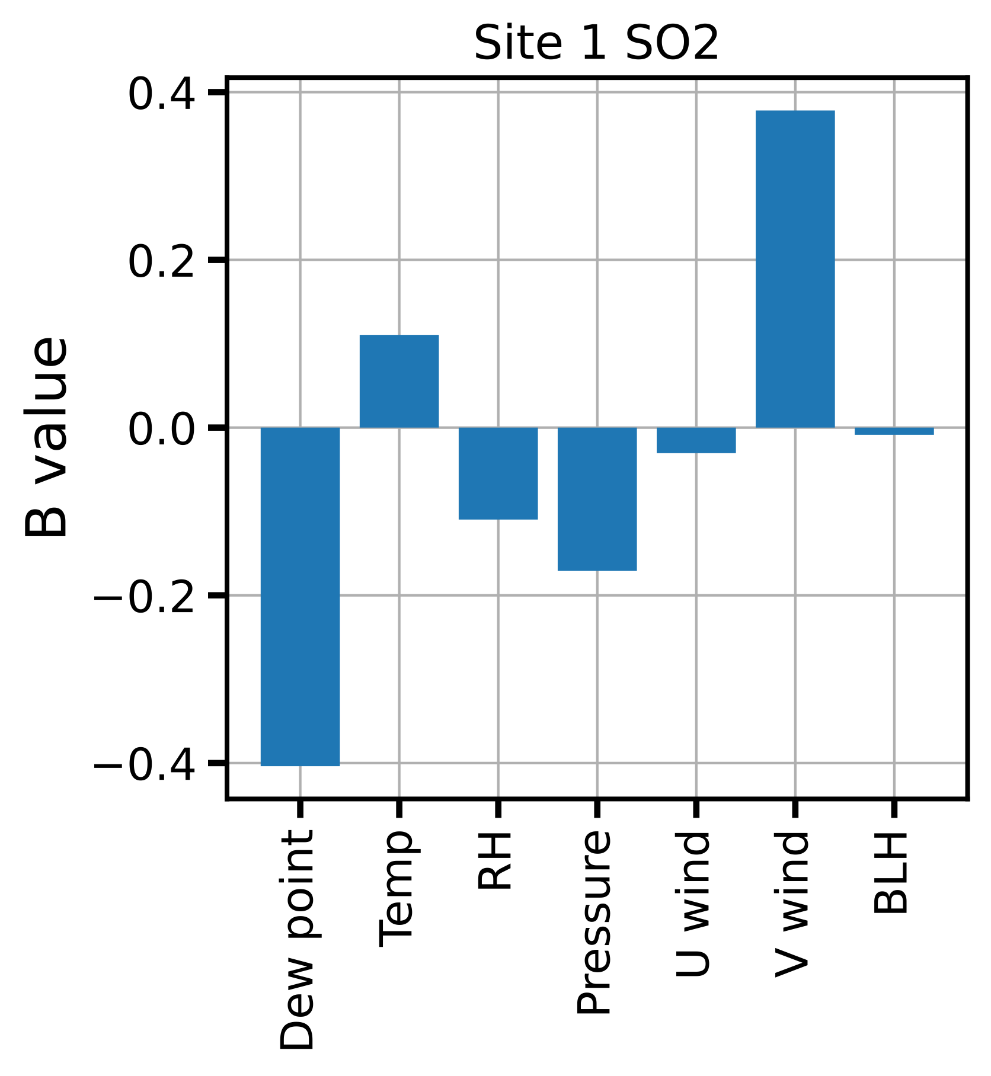
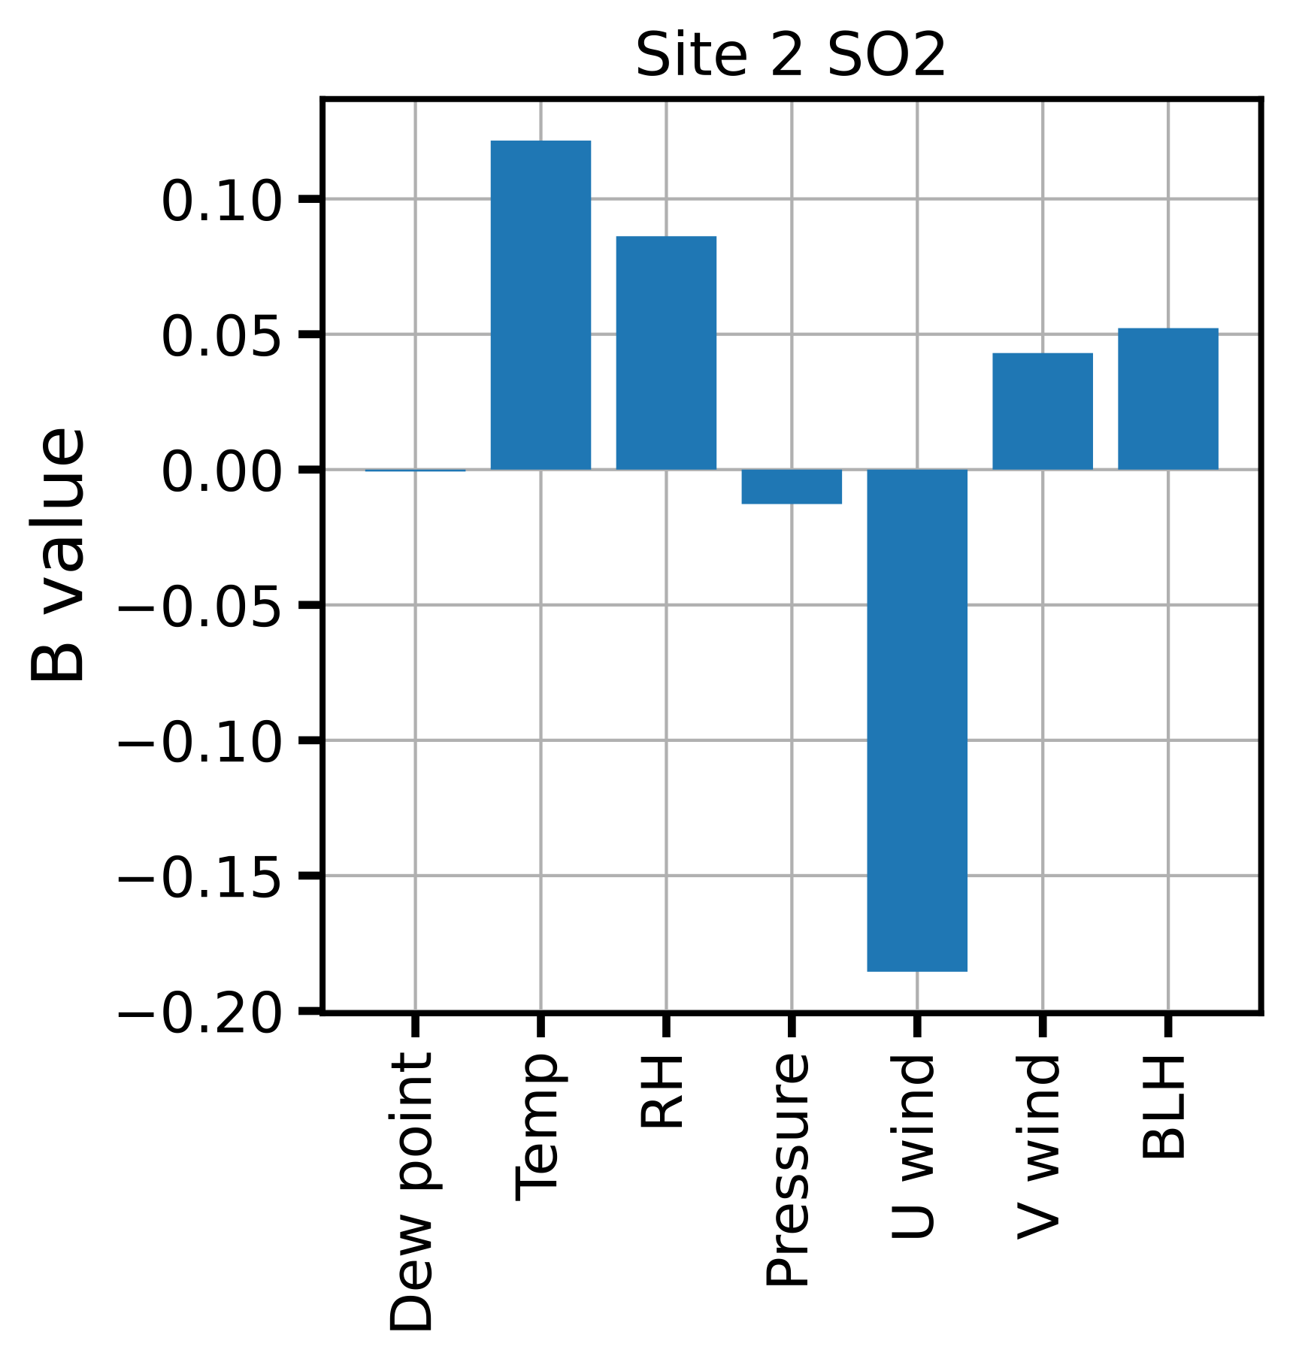
B Matrix Analysis
B Matrix Shape: [#sites * #contaminants, #sites * #variables] = [204, 238]
e.g., contribution of site 10’s RH to site 2’s SO2 level
Standard deviation is very large (100x), this is a complex dynamic system

Slide 19
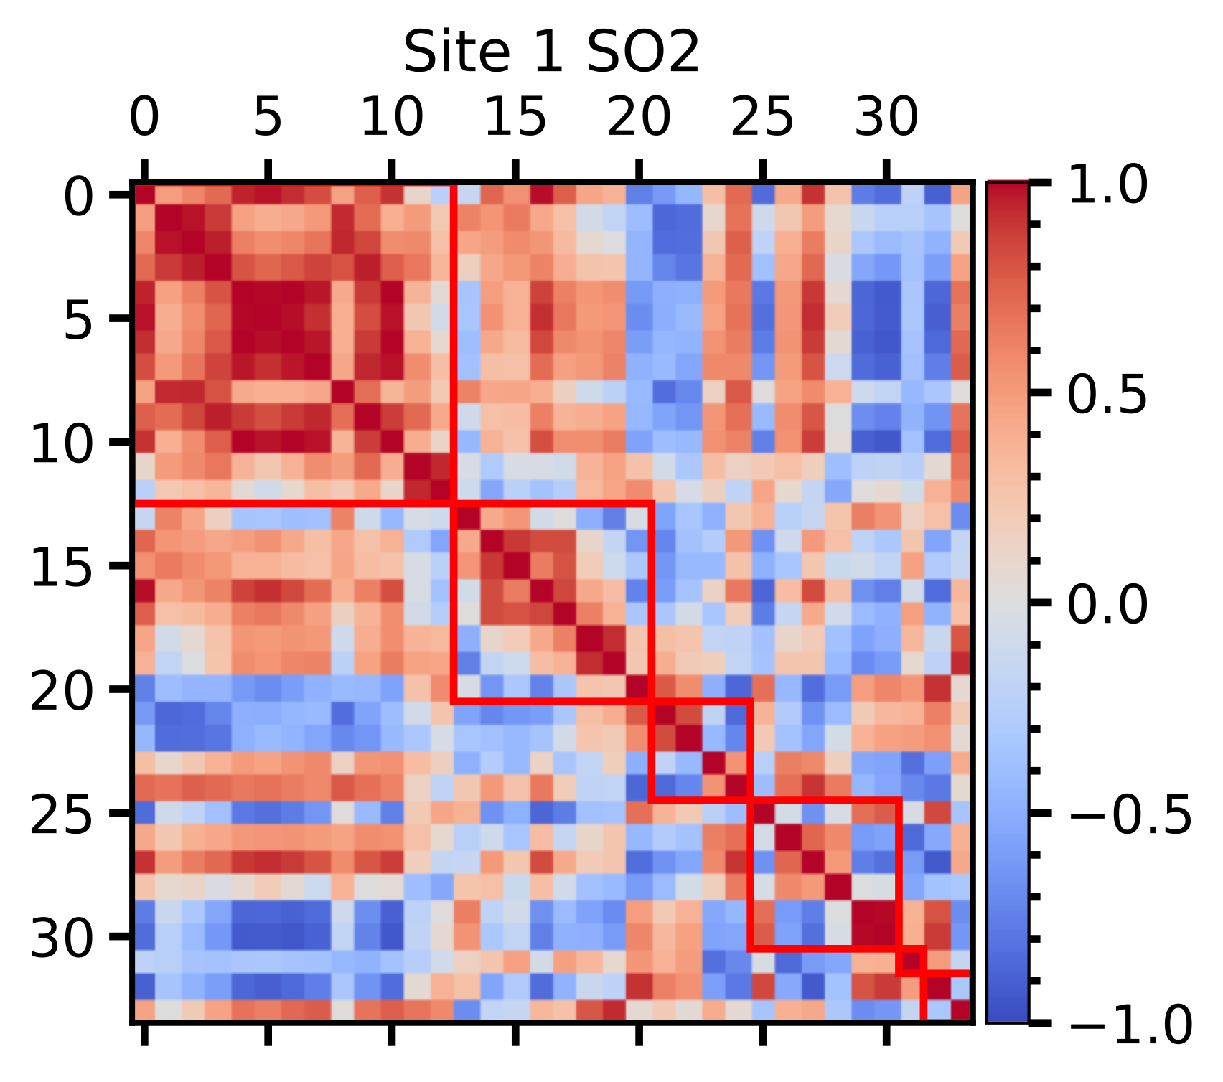
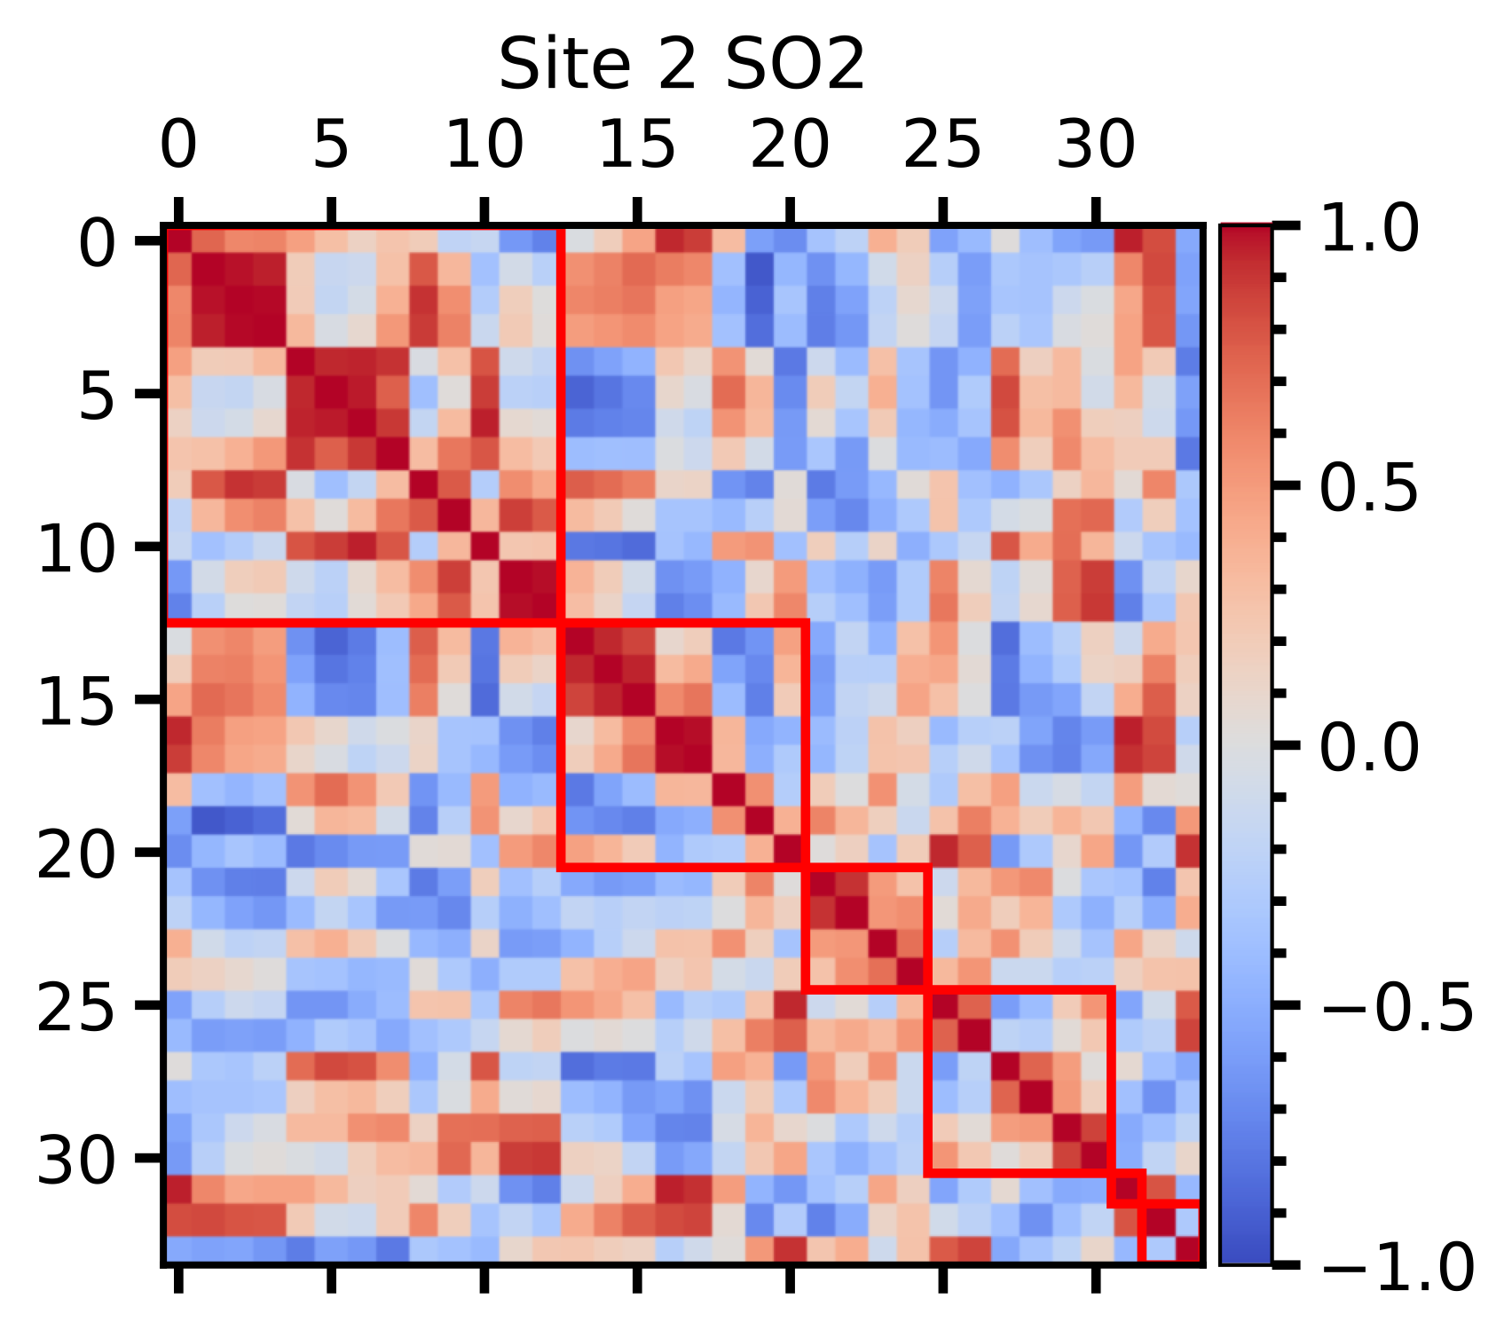
B Matrix Analysis
Clear clustering effect in downtown area.
The variables affect SO2 in downtown area are in a similar way.

Slide 20
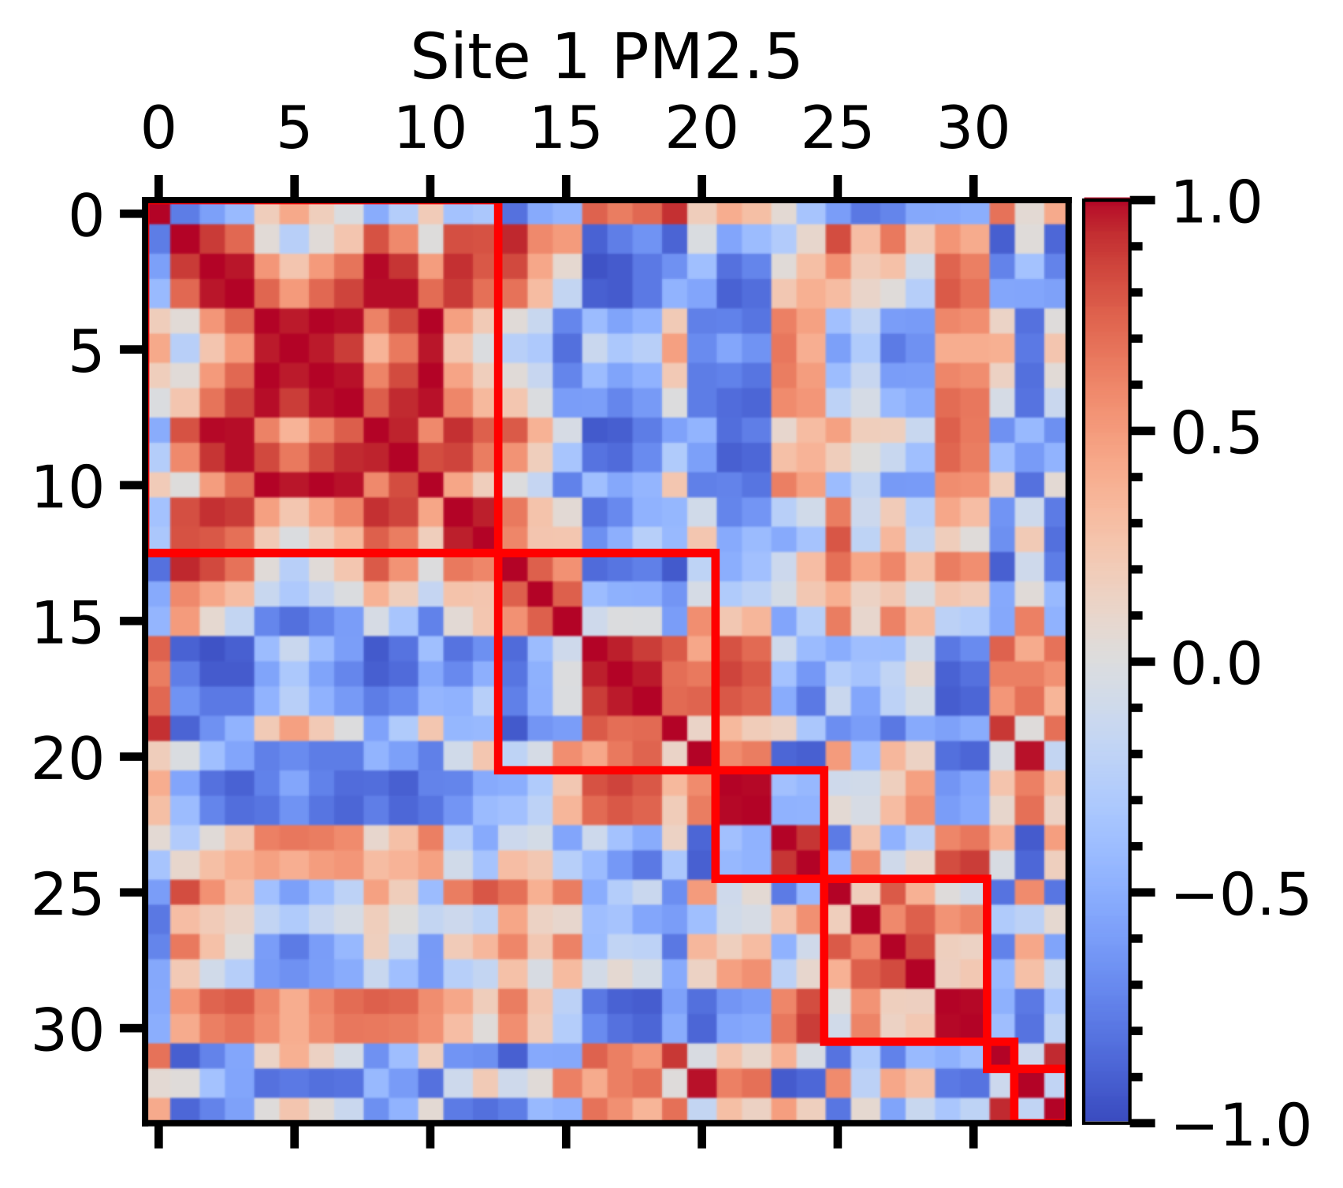
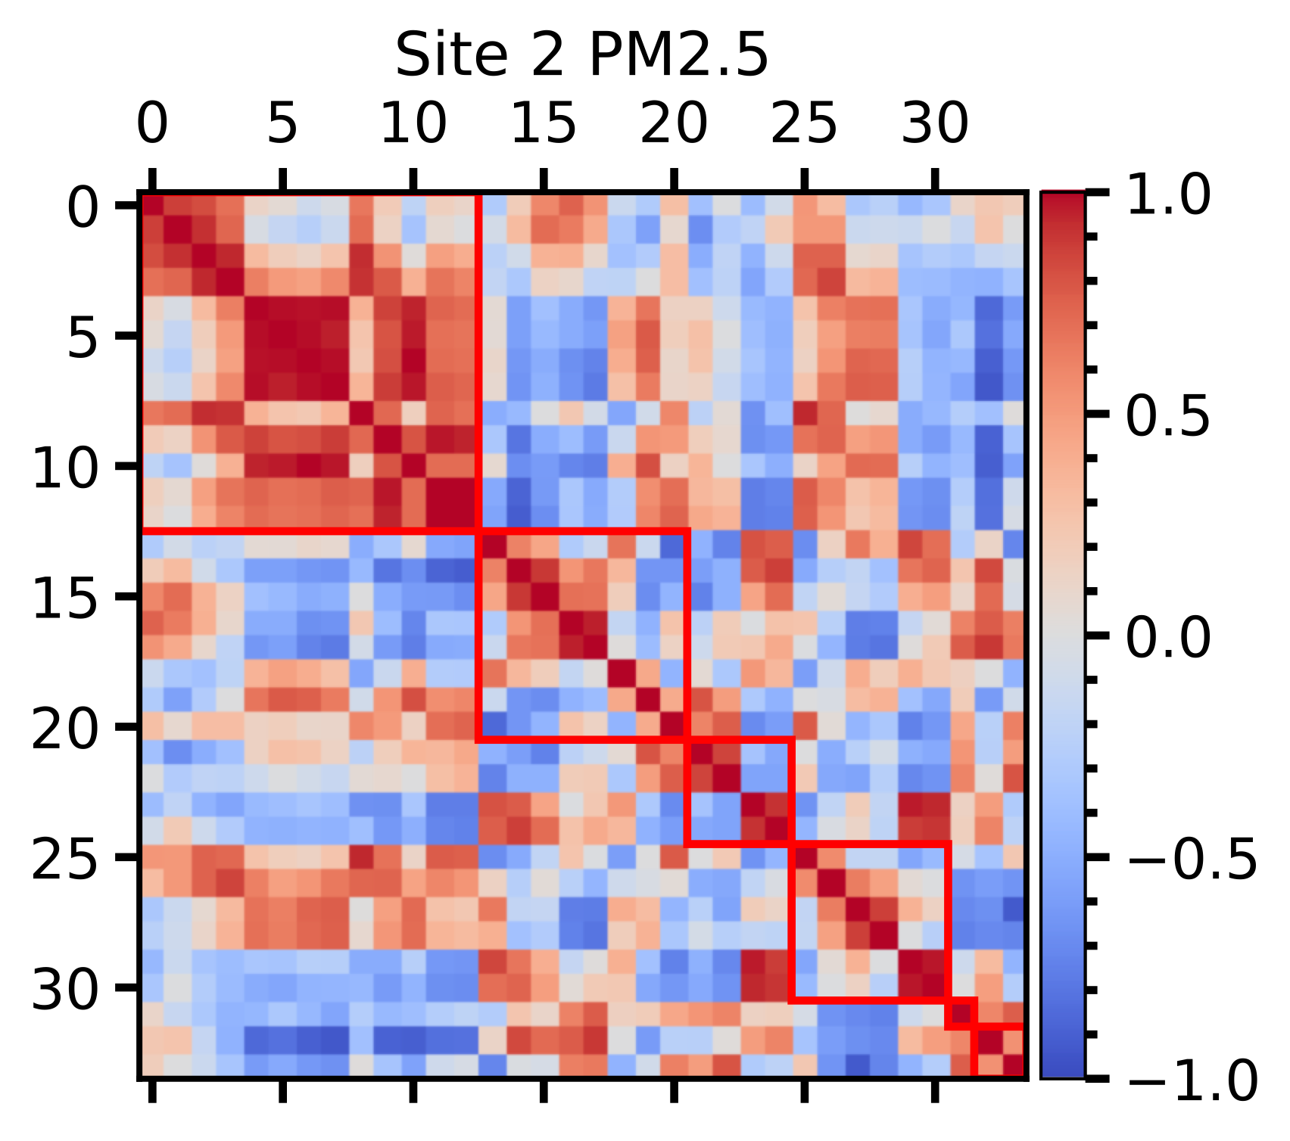
B Matrix Analysis
Clear clustering effect in downtown area.
The variables affect PM2.5 in downtown area are in a similar way.

Slide 21
Next Step
Extend the study to a whole year
Including long term forecasting comparison between DMD and DMD with time delay.
Besides PCA, check other data representation.
Besides site clustering, consider other interaction, e.g., distance.

Slide 22
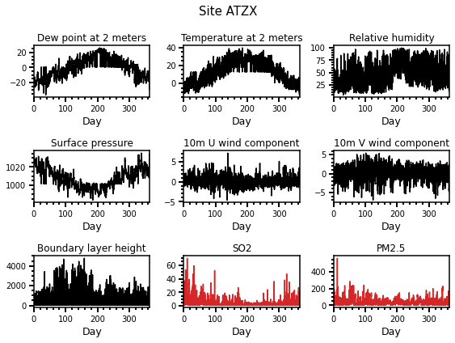
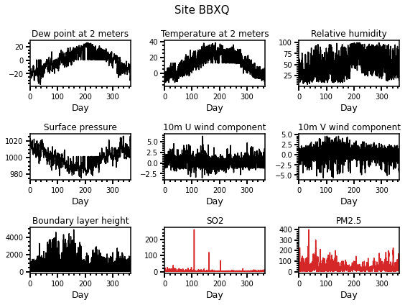
Data
34 sites. 365 days. 7 features. 2 predicted labels.

Slide 23
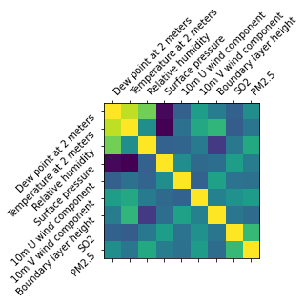
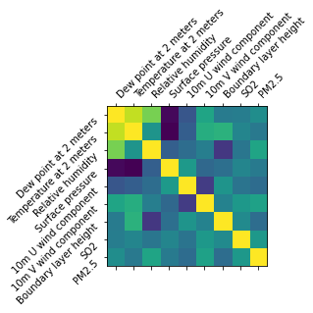
Correlation
Site ATZX
Site BBXQ
Dew point at 2 m is positively correlated with temperature.
Dew point at 2 m is negatively correlated with pressure.

Slide 24
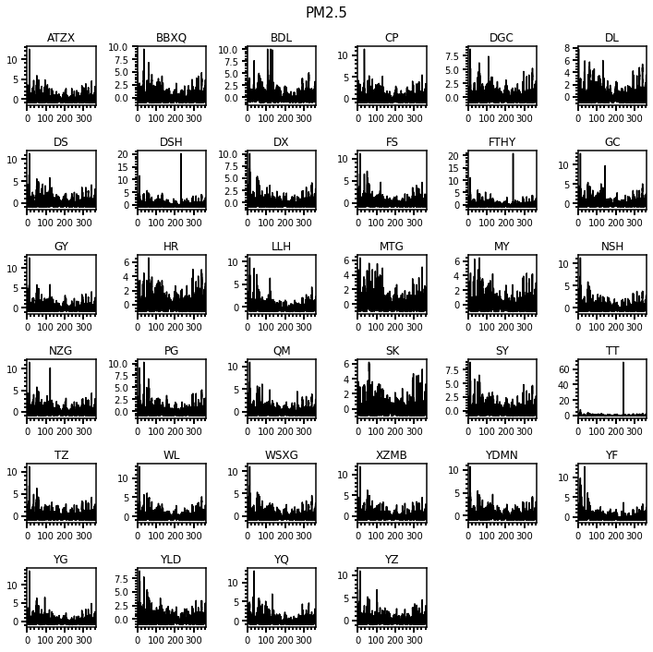
PM2.5
PM2.5 is high during winter.

Slide 25
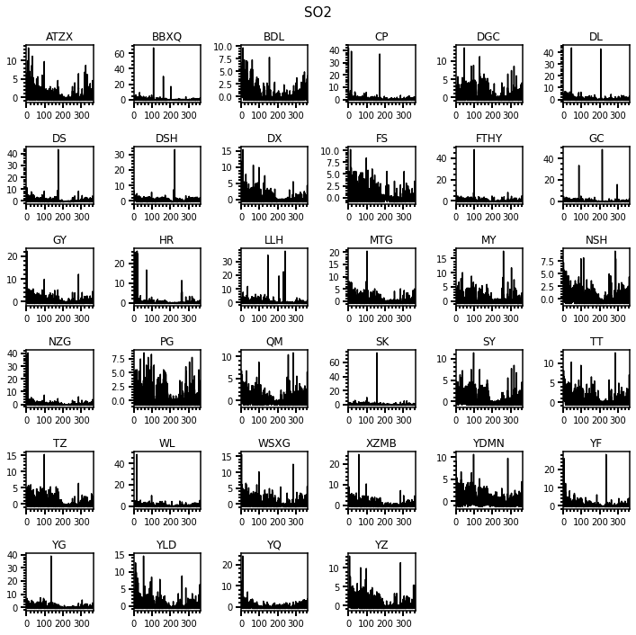
SO2
SO2 is high during winter.

Slide 26
Motivation
Recover the dynamics
Predict the PM2.5 and SO2 in the future
Understand the contribution of features
Consider the features from all sites

Slide 27
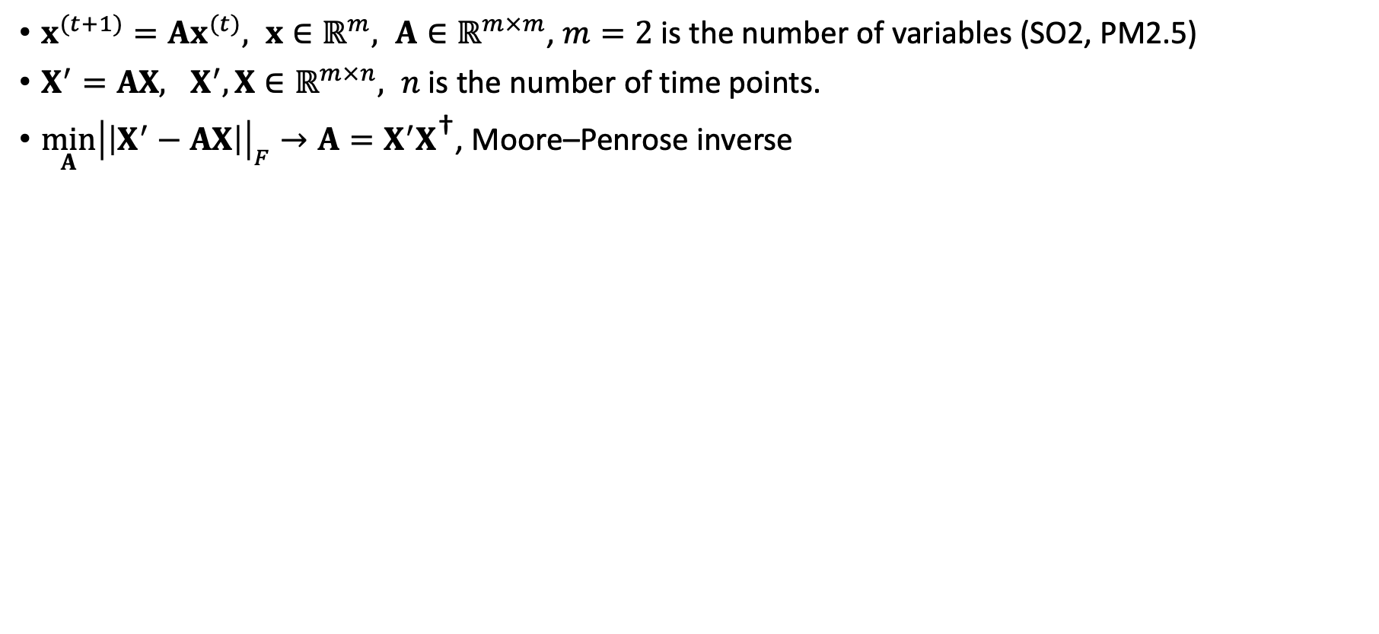
Dynamic Mode Decomposition
$x^{(t+1)}=Ax^{(t)}, x∈ℝ^{m}, A∈ℝ^{m×m}$, $m=2$ is the number of variables (SO2, PM2.5)
$X^{′}=AX, X^{′},X∈ℝ^{m×n}, n$ is the number of time points.
$\min_{A}{{\left|\left|X^{′}−AX\right|\right|}_{F}}→A=X^{′}X^{\text{†}}$, Moore–Penrose inverse
1 hr advance. 4 days for reconstruction. 2 days for prediction.

Slide 28
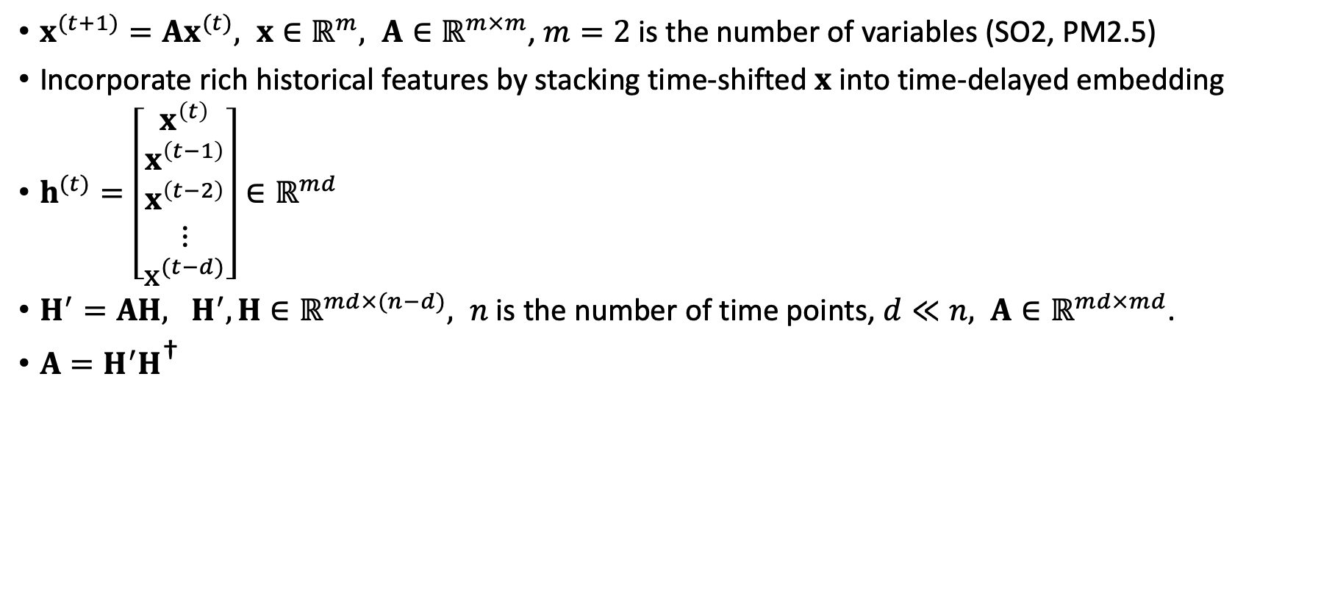
DMD with Time Delay
$x^{(t+1)}=Ax^{(t)}, x∈ℝ^{m}, A∈ℝ^{m×m}$, $m=2$ is the number of variables (SO2, PM2.5)
Incorporate rich historical features by stacking time-shifted $x$ into time-delayed embedding
$h^{(t)}=\left[\begin{matrix}x^{\left(t\right)} \\ x^{\left(t−1\right)} \\ x^{\left(t−2\right)} \\ ⋮ \\ x^{(t−d)}\end{matrix}\right]∈ℝ^{md}$
$H^{′}=AH, H^{′},H∈ℝ^{md×(n−d)}, n$ is the number of time points, $d≪n, A∈ℝ^{md×md}$.
$A=H^{′}H^{\text{†}}$

Slide 29

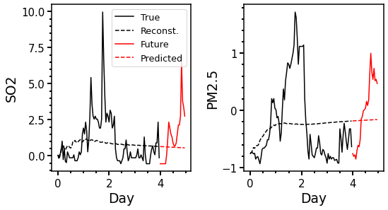
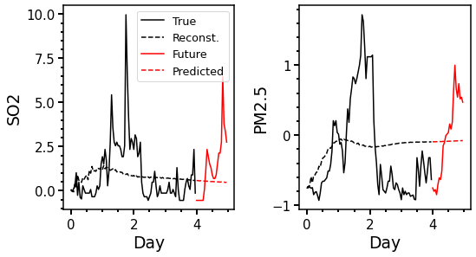
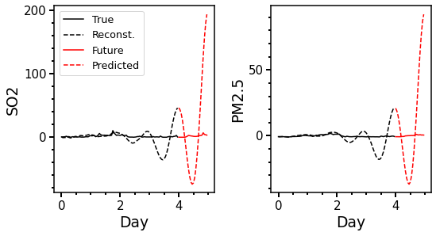
DMD with Time Delay
n=96, d=2
d=12
d=16
d=24
Explode

Slide 30
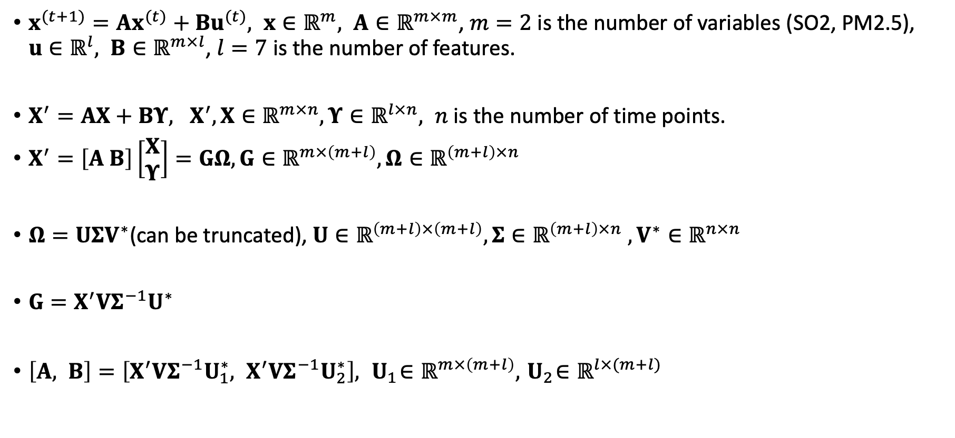
DMD with Forcing
$x^{(t+1)}=Ax^{(t)}+Bu^{(t)}, x∈ℝ^{m}, A∈ℝ^{m×m}$, $m=2$ is the number of variables (SO2, PM2.5), $u∈ℝ^{l}, B∈ℝ^{m×l}$, $l=7$ is the number of features.
$X^{′}=AX+BΥ, X^{′},X∈ℝ^{m×n},Υ∈ℝ^{l×n}, n$ is the number of time points.
$X^{′}=\left[A B\right]\left[\begin{matrix}X \\ Υ\end{matrix}\right]=GΩ,G∈ℝ^{m×\left(m+l\right)},Ω∈ℝ^{\left(m+l\right)×n}$
$Ω=UΣV^{∗}$(can be truncated), $U∈ℝ^{\left(m+l\right)×\left(m+l\right)}, Σ∈ℝ^{\left(m+l\right)×n}$ $, V^{∗}∈ℝ^{n×n}$
$G=X^{′}VΣ^{−1}U^{∗}$
$\left[A, B\right]=\left[X^{′}VΣ^{−1}U_{1}^{∗}, X^{′}VΣ^{−1}U_{2}^{∗}\right], { U}_{1}∈ℝ^{m×\left(m+l\right)},{ U}_{2}∈ℝ^{l×(m+l)}$

Slide 31
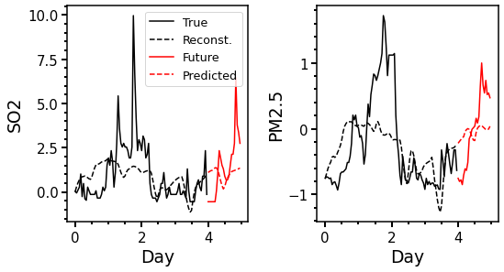
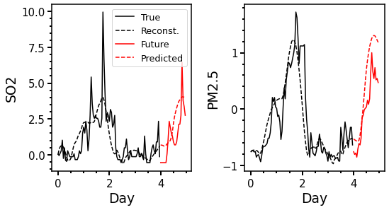
DMD with Forcing
Truncation = 5
No truncation (r=9)
DMD with forcing has smaller errors.
Low rank approximation can be tested in the future.

Slide 32
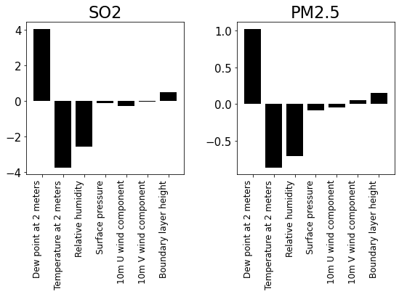
DMD with Forcing
Dew point, temperature, and RH are most important.

Slide 33
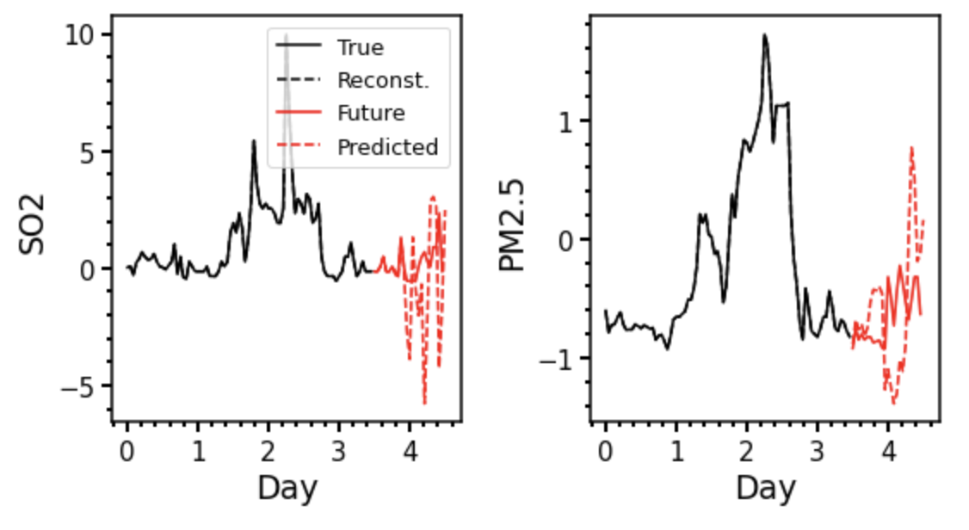

DMD with Time Delay and Forcing
Zero reconstruction error. Large prediction error.
Can tune the time delay value, and force truncation.

Slide 34
Summary
Method | Reconstruction Error | Prediction Error
DMD | 0.8411 +/- 0.4971 | 0.8021 +/- 0.4657
DMD with Time Delay (6) | 0.7924 +/- 0.4920 | 0.7785 +/- 0.4283
DMD with Forcing | 0.5195 +/- 0.2957 | 0.9488 +/- 0.8582
DMD with Time Delay and Forcing | 0.0000 +/- 0.0000 | 3.0162 +/- 7.2578
By tuning the time delay value, and force truncation,
We can find optimal method.

Slide 35
Simple DMD with 34 sites
Single Site
All sites
Considering multi-site reduces error.

